Slide 1
Treatment of Clients Experiencing Anxiety
A Collaborative Approach to Care
February 24, 2018 * Tex-CHIP Training Series

Slide 2
Role of Nutrition & Lifestyle in Prevention/Management of Anxiety Symptoms

Slide 3
Understanding Provider Role in Preventing and Treating Anxiety
Nutritional assessment:
Foods, beverages, supplements, and medications
Eating patterns, allergies, therapeutic adjustments (viscosity of beverages) bowels, food preferences and aversions, socioeconomic barriers, and religious beliefs
Work with co-occurring medical conditions (diabetes, heart disease, IBS, elevated cholesterol, high blood pressure, kidney disease)
Setting for treatment:
psychiatric facilities
group homes
early intervention programs
outpatient clinics
patient’s own home
Notes:
A RDN will complete a nutritional assessment of the complete diet; including foods, beverages, supplements, and medications that influence the medical status of that individual. Eating patterns, allergies, therapeutic adjustments (e.g., viscosity of beverages), food preferences and aversions, socioeconomic barriers, and any religious beliefs that influence food consumption are also assessed or considered. Individuals with behavioral health concerns may also have co-occurring medical conditions that require attention from the RDN. A few of these include diabetes, heart disease, irritable bowel syndrome, elevated cholesterol, high blood pressure, kidney disease, food allergies, or potential food/drug interactions.

Slide 4
Considerations when Interacting with Clients
Identify pattern in food recall
Overall appetite
Eating disorder
Obesity
Co-morbidities
Blood glucose
Caffeine & Alcohol intake
Cooking
Vitamin D deficiency
Social Anxiety, Phobias
Depression present
Exercise
Notes:
May not eat at all
Or may over eat for comfort
Social Anxiety – can order food online
Phobias – removing food groups completely
Half of those with depression also experience anxiety

Slide 5
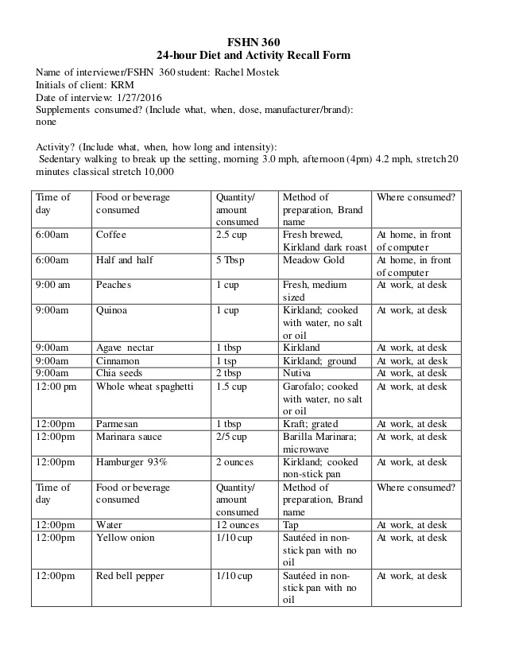
Food Recall
Time or meal
Food
Quantity
Method of prep
Where consumed
Notes:
Start where diet is at → improvement, even just 1 change

Slide 6
Goals & Related Interventions
Goals:
No skipped meals
More brain foods
Reduced sugar and processed foods
Reduce/eliminate caffeine, alcohol
Keep blood glucose normal
Cook meals at home
Exercise 1-2 days a week (30 minutes)
Interventions:
Eat every 3-4 hours
Goal setting
Check and log blood sugar (if needed)
On-line grocery shopping
Exercise log/app
Notes:
sugar can cause a 10-fold increase in epinephrine levels
Interventions are more for those outpatient or more independent – if they’re institutionalized different food situation. Where RDN needs to be involved with kitchen too to make sure what’s being served.

Slide 7
Specific Nutrients
Magnesium:
Whole grains, oats
Seeds, nuts, peanuts
Leafy greens
Yogurt
Dark chocolate (>70%)
Omega-3 (Supp. 1-3g/day)
Salmon, tuna
Grass-fed beef and dairy
Flax and chia seeds
Walnuts
Polyphenols (antioxidants)
Berries, cherries
Plums, apples, pomegranates,
Spinach, broccoli
Black beans
Black olives
Soy milk, soy yogurt
Turmeric
Notes:
Decreases oxidative stress
Bioavailability The richest sources are (up to 1.2 g/kg fresh wt), curly kale, leeks, broccoli, and blueberries
There are supplements – but natural food sources are the best

Slide 8
Specific Nutrients (cont’d)
Gamma-aminobutyric acid (GABA) neurotransmitter
Yogurt and fresh cheeses (parmesan, provolone, cheddar),
Almonds,
Bananas and citrus,
Broccoli and spinach,
Brown rice, oatmeal
Probiotics
yogurt
pickles,
sauerkraut
kefir
Zinc – cashews, beef, eggs
Vitamin D – cheese, eggs, milk, enriched cereals, mushrooms
Notes:
95% of serotonin receptors are found in the lining of the gut

Slide 9
Measuring Outcomes/ Success
Food Journal:
Eating 3-5 meals a day (include 1 brain food in each meal)
Balance in diet
Limit sugar and replacing simple carbs with whole grains
Elimination of caffeine, alcohol
Stabilized blood sugar
Cook at least 1-2 meals at home a week
Exercise 1-2 days per week for 30 minutes

Slide 10
Communication from Counselors
Your assessment – all team members all be on same page
Phobias
What their drinking
May disguise as food intake
Notes:
The practice of clinical dietetics in mental health includes working with medical teams that include psychiatrists, psychologists, social workers, psychiatric nurses, pharmacists, mental health technicians, substance abuse counselors, activity therapists, speech therapists, occupational therapists, physical therapists, wound care specialists, medical records staff, food service administrators and food service staff.
Don’t assume we don’t care – more information the better
At Driscoll all disciplines sat down together to discuss – however won’t have that time so all need to be on the same page and if another health professional is saying something
Phobias – can’t be in public, with crowds, handling a knife

