Slide 1
Treating the Trauma Response
Tex-CHIP Training Series

Slide 2
Discussion Overview
Establish context through some quick facts about trauma in the US
Understand the Trauma Response
Describe 3 sources of trauma & types of responding
Discuss CPT as a manualized treatment
Demonstrate and Practice CPT modules

Slide 3
Establishing Context
Everyone has trauma
90% of US adults report being exposed to something notably traumatic
Unresolved trauma reactions may be at the core of many developmental, relational, or clinical impairments
To increase intrapersonal well-being and interpersonal functioning, meaningful and efficacious treatment is an imperative

Slide 4
Sources of Trauma
Many possibilities, but also some distinct categories
Threats to our body
Environmental and disaster-related events
Relational trauma

Slide 5
Types of Response
Traumatic Experience
Natural Recovery Response
Persistence of Trauma Symptoms
Recovery through treatment
Compounding of symptoms through non-treatment

Slide 6
Clinical Symptoms of PTSD
From the medical model perspective
Exposure to traumatic material (direct or indirect)
Intrusion symptoms (flashbacks, nightmares, physio)
Negative changes in cognitions and mood
Alternations in arousal or activity level
Duration- ASD versus PTSD
Functional significance

Slide 7
Clinical Symptoms of PTSD
From a Wellness, Strength-based Perspective
Alterations in positive emotions and happiness
Decreased engagement with life activities
Affected social relationships
Disrupted perceptions of meaning and existential well-being
Impediment to activities that promote sense of accomplishment

Slide 8
3 Sources of Trauma Response
Biological dysregulation
Behavioral explanations of trauma-focused interventions
Behavioral theory
Cognitive-emotional processing theory
Cognitive explanations of trauma-focused interventions
Social cognitive theory of PTSD

Slide 9
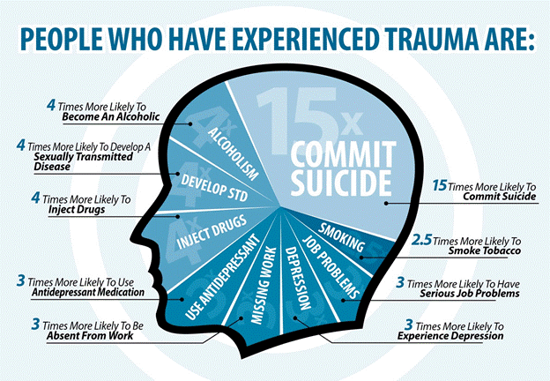
Establishing Context
Research linking trauma exposure to delinquency is far-reaching and convincing.
Small studies, specific studies, huge studies, over time
Here’s what we know:
Delinquent youth almost always polyvictims
People who are polyvictims tend to be aggressive & destructive
Peer victims tend to emerge as those who get into physical fights, carry guns, and commit violent crimes
Findings persist after considering age, gender, ethnicity, mental health diagnoses

Slide 10
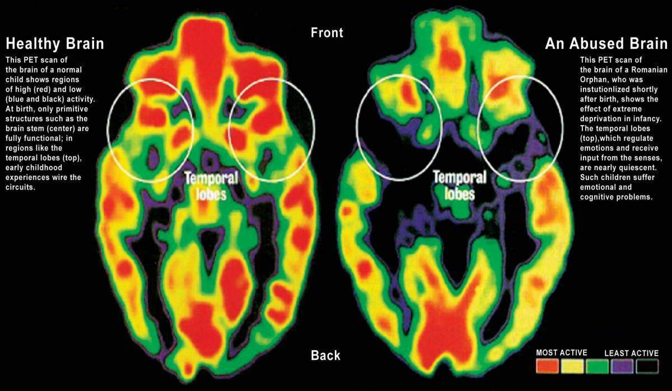
Changes in the brain
Neurocircuitry models make reference to some important brain areas
Amygdala, medial prefrontal cortex and anterior cingulate, and hippocampus
Activity in these areas is markedly different in kids with trauma history than without

Slide 11
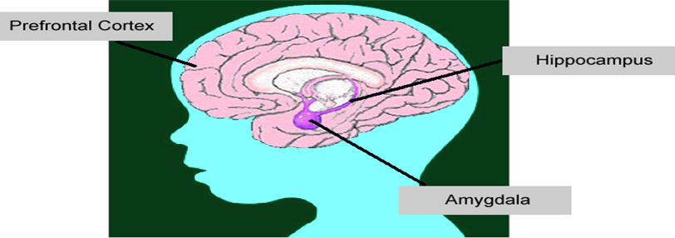
Consequences: Low Road Versus High Road
Anterior cingulate
Neutral event
High Road
Prefrontal cortex
Low Road
Amygdala
Objectively think about things
Make decisions that inform feelings
Hippocampus
Fight or flight response
Feared memories
Traumatic memories are cued
Reliving of previous experiences

Slide 12
Behavioral Conceptualizations
Mowrer2 provided a framework for development and maintenance of fear responses
Classical Conditioning explains on onset/acquisition of fear response
Operant Conditioning maintains response through avoidance of fear provoking stimuli

Slide 13
Emotional Processing Theory
Foa’s3 practice-based theory integrated meaning into the learned response
In response to traumatic experience, we develop meaning structures with stimulus and physiological responses
Maintenance and recovery moderated by three factors:
Degree of emotional engagement
Quality of trauma-related cognitions
Degree of narrative articulation

Slide 14
Social Cognitive Theory of PTSD
Assimilation
Just-world thinking
Hindsight bias
Happily ever after thinking
Over-
accommodation
Use traumatic event as proof of negative belief
Related to safety, trust, power/control, esteem, and intimacy
Keys to Recovery
Experience natural emotions
Correct misappraisals associated with manufactured emotions
Resick and colleagues4 depicted this model in the treatment of individuals with PTSD.
Avoidance of thinking about the event and problematic appraisals of event contribute to non-recovery.
Largely moderated through cognitive assimilation

Slide 15
Cognitive Processing Therapy
Addressing Neurological, Behavioral, and Cognitive Components to Promote Recovery & Well-Being

Slide 16
Structure of Sessions
1: Overview of CPT and Reviewing Index Trauma
2 & 3: Finding Stuck Points
4 & 5: Processing the Index Event
6 & 7: Challenging Problematic Thinking
8 - 10: Challenging & Processing issues of Safety, Trust, Power/Control, and Esteem
11 & 12: Addressing Intimacy and Termination

Slide 17
Session 1 Overview of CPT and Reviewing Index Trauma
GOALS:
Client understands:
How they got stuck in their recovery
PTSD
How CPT helps
PROCEDURES:
Set agenda
Describe symptoms of PTSD
Describe cognitive theory
Discuss role of emotions in trauma recovery
Briefly review the index trauma
Describe overall course of therapy
Give first assignment
Check in on clients reactions to session

Slide 18
Session 2: Finding Stuck Points
GOALS:
Review Impact Statement
Identifying stuck points
Beginning self-monitoring activities
PROCEDURES:
Review PCL & PHQ
Client reads Impact Statement
Help identify and recognize connections between events, thoughts, and feelings
Help differentiate between facts and thoughts
Introduce ABC worksheet
Further address Stuck Points
Assign practice task
Check in client reactions and process session

