Slide 1
How to deal with depression and increase happiness
Javier Cavazos Vela, Ph.D., LPC
Jcvela1984@gmail.com

Slide 2


What is depression?
“Five (or more) of the following symptoms have been present during the same 2-week period and represent a change from previous functioning; at least one of the symptoms is either (1) depressed mood or (2) loss or interest of pleasure” (DSM-5)

Slide 3
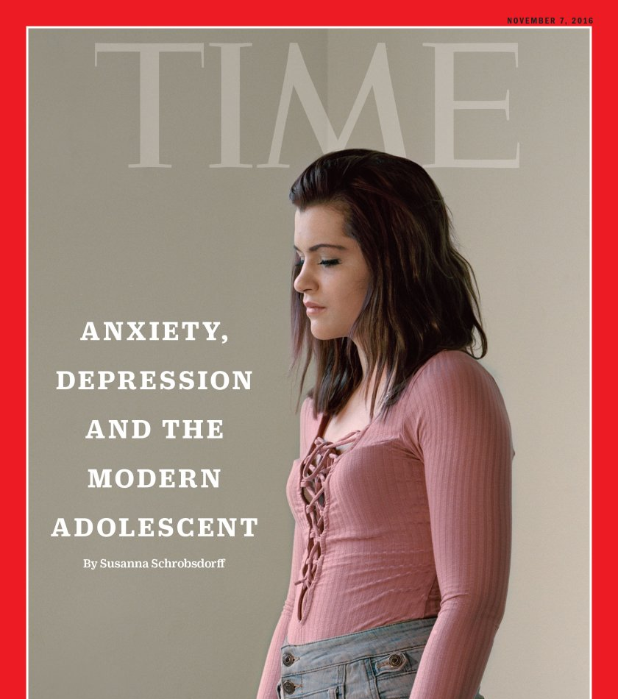

Why is depression important?

Slide 4

Important red flags
Depressed mood
Diminished interest or pleasure in activities

Slide 5
Important red flags
Feelings of worthlessness
Recurrent thoughts of death

Slide 6
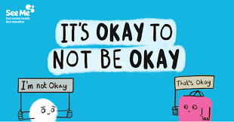

Why is depression important?

Slide 7
ABCD Method
Treatment Manual for Cognitive Behavioral Therapy for Depression

Slide 8
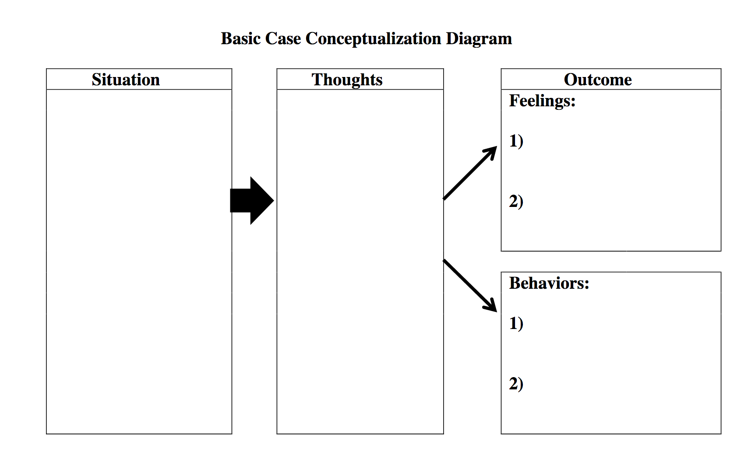
Sample worksheet (Lenz, 2018)

Slide 9
Identify thinking traps
Dichotomous
Overgeneralization
Personalization
Catastrophizing

Slide 10
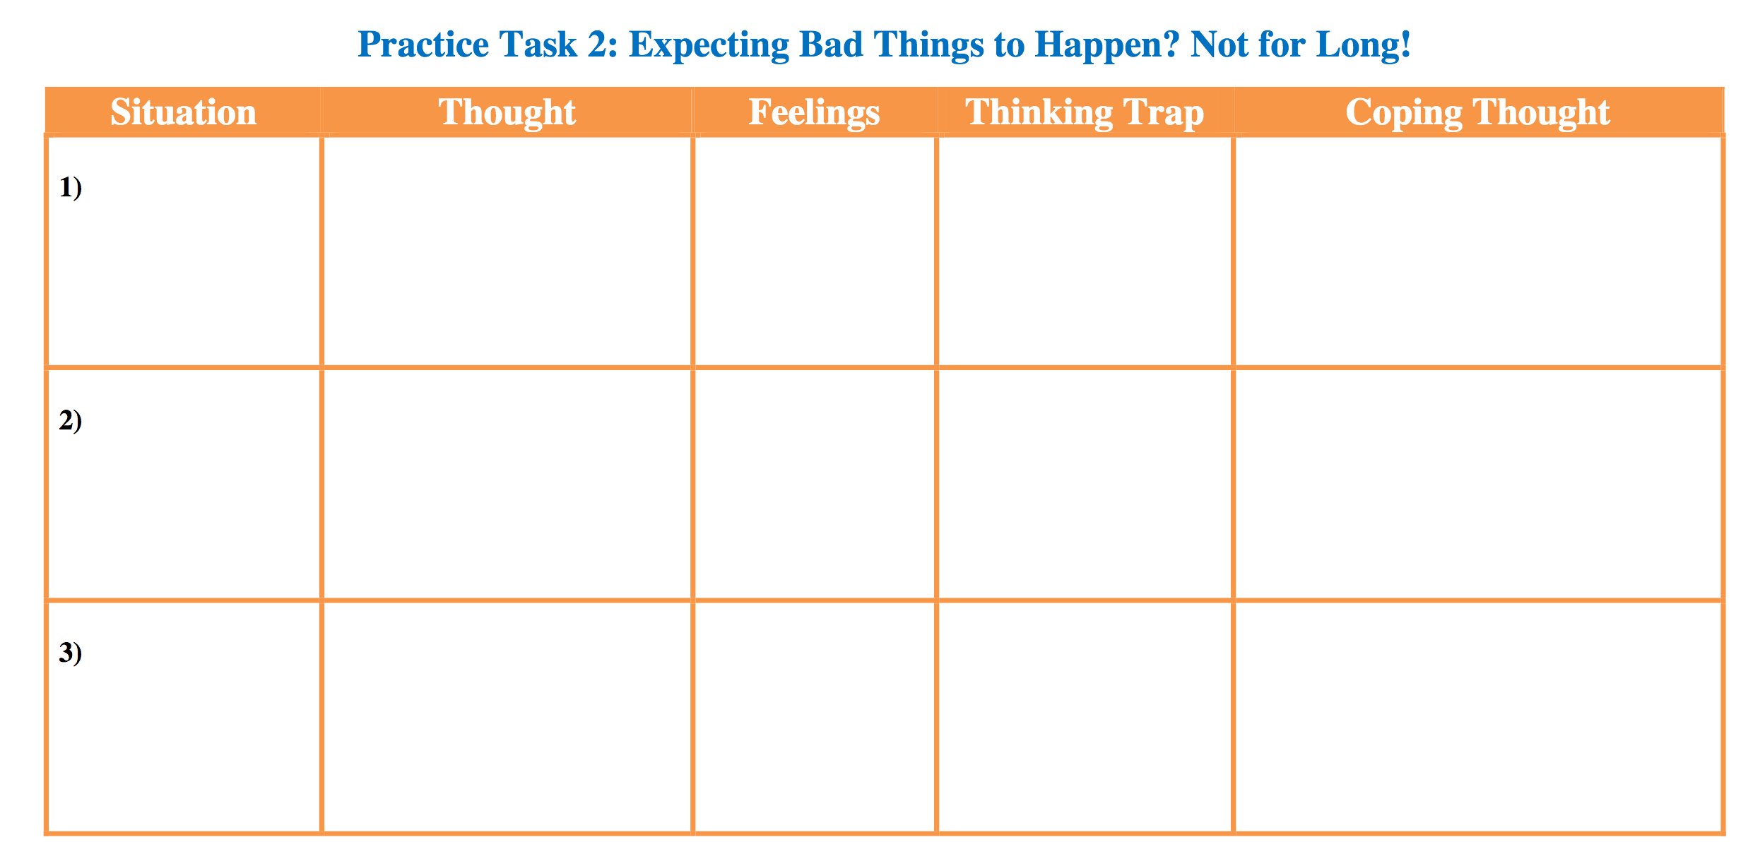
Sample Worksheet

Slide 11


Slide 12
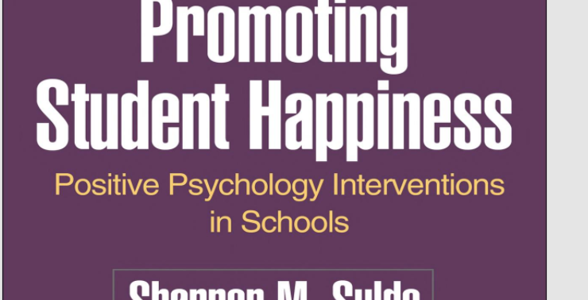

Slide 13
The Well-Being Promotion Program
Past (gratitude)
Present (character strengths, savoring, and kindness)
Future (hope and optimism)

Slide 14

express gratitude

Slide 15
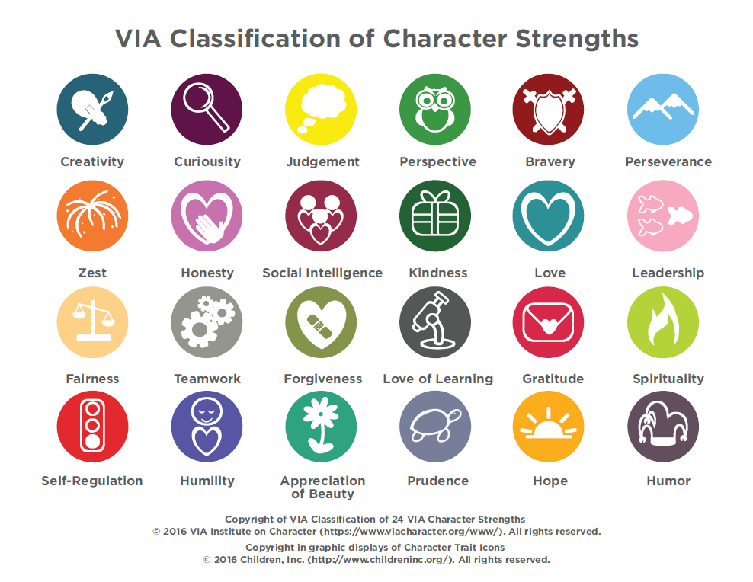
Cultivate Character strengths

Slide 16
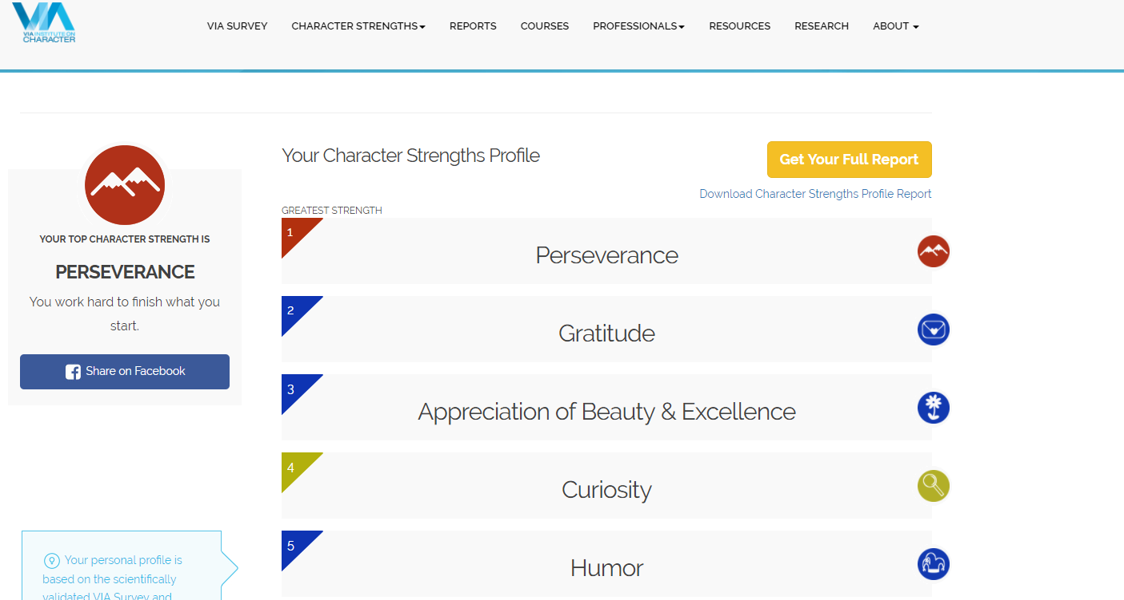
Sample character strengths profile

Slide 17
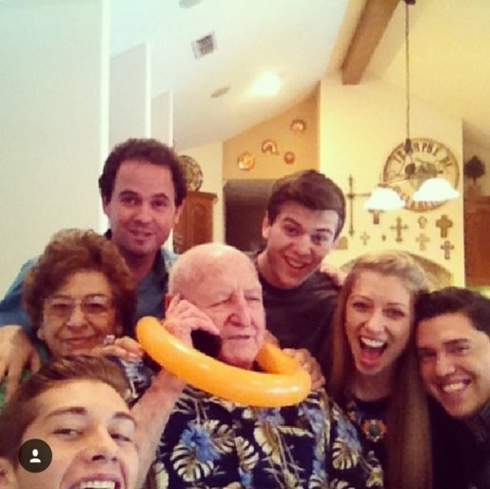
savoring

Slide 18

Acts of kindness

Slide 19


Optimism

Slide 20

Final focus activity

Slide 21
References and helpful resources
Diagnostic and Statistical Manual of Mental Disorders (2013). American Psychiatric Association.
Goldsmith, B. (2017). 10 tools for dealing with holiday stress and depression. Retrieved from https://www.psychologytoday.com/blog/emotional-fitness/201112/10-tools-dealing-holiday-stress-and-depression
Lenz, A. S. (2018). Cognitive behavioral therapy for anxiety: An application of the FEAR model for adults. Retrieved from http://cnep.tamucc.edu/texchip/files/materials_20180224/cbt_for_anxiety_manual.pdf
Munoz, R. F., Aguilar-Gaxiola, S., Guzman, J., Rossello, J., & Bernal, G. (2007). Treatment manual for cognitive behavioral therapy for depression: Adaptation for Puerto Rican adolescents.
Penn Resiliency Program and PERMA workshops (2016). Retrieved from https://ppc.sas.upenn.edu/services/penn-resilience-training
Seligman, M. (2002). Authentic happiness: Using the new positive psychology to realize your potential for lasting fulfillment.
Suldo, S. M. (2016). Promoting student happiness: Positive psychology interventions in schools.
VIA Institute on character. Retrieved from http://www.viacharacter.org/www/Character-Strengths-Survey

