Slide 1
Anxiety
Treating Anxiety Symptoms Among Older Adults using a Worry Reduction Program
(Calmer Life Program)
Presented by: Melissa K Rollins, M.S., CCATP

Slide 2
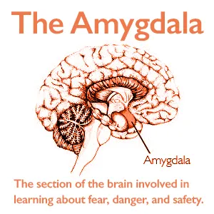
What is Anxiety?
A biological reaction – the bodies way of telling us something isn’t right
In the brain -- the amygdala (fight or flight response)
Surge of hormones (cortisol) and adrenaline

Slide 3
Anxiety Disorder in America
Most common mental health condition for adults
Over 40 million American adults
(18 and older) diagnosed
Affects 31.9% of adolescents
(13-18 years of age)
Develops for a number of reasons, including genetics, brain chemistry, and life events
Treatable condition (therapy, medications, holistic approaches)
More than 60% of people struggling with Anxiety Disorder do not receive treatment

Slide 4
Types of Anxiety
Post Traumatic Stress Disorder (PTSD)
Generalized Anxiety Disorder
Obsessive-Compulsive Disorder
Social Anxiety Disorder
Everyday anxiety
Agoraphobia
Panic Disorder
Phobia
Stress
Worry

Slide 5
Symptoms of Anxiety
Uncontrollable feelings of panic
Obsessive thoughts
Reactions that are disproportionate to the triggering fear
Restlessness
Trouble with memory and focus
Insomnia
Nightmares
Refusal to engage in routine activities
Ritualistic behaviors (e.g. repeated handwashing)

Slide 6
Physical Symptoms of Anxiety
Racing heart, or heart palpitations
Trembling
Hot flashes
Headaches
Frequent urination
Shortness of breath
Nausea
Tense muscles
Excessive sweating
Cold or sweaty hands
Dry mouth

Slide 7
Treatment for Anxiety Disorders
Mental Health Therapy
Cognitive Behavioral Therapy (CBT)
Acceptance and Commitment Therapy (ACT)
Exposure and Response Prevention (ERP)
Mindfulness-based Cognitive Therapy (MBCT)
Prescribed Medication
SSRIs/ SNRIs
Vistaril
Buspar
Abilify and Seroquel
Benzodiazapines
Beta blockers

Slide 8
Treatment for Anxiety Disorders (cont.)
Stress management techniques
Breathing techniques
Progressive muscle relaxation
Lifestyle modifications
Getting enough sleep
Exercise
Avoiding alcohol, illegal drugs, excessive caffeine

Slide 9
CASE STUDY
June is a 73 year old woman who is a new patient recently referred to the primary care clinic and seeing Matt, the NP. She is seeking a refill for her lorazepam, which she has been taking for anxiety/poor sleep since her husband’s death 10 years ago. Her prescribed dose is 1 mg at bedtime, but she has been taking 2 mg at bedtime for the last 2 to 3 months due to poor sleep. She also takes a tablet during the day with glass of scotch for anxiety. Her other medications include candesartan and paroxetine for depression. June is a patient in the clinic so Matt has her health history available on the EMR. Matt takes a full health history. Pertinent findings in relation to this CDS use vignette is reported here.

Slide 10
Case study – cont.
She tells Matt that she had an ED visit 2 months ago after a motor vehicle accident where she crashed her car into a parked car while driving home from the grocery store. She received a refill for her lorazepam at that time. Finally, she fell at home 3 weeks ago after tripping while taking out the garbage. She did not present for assessment but thinks she sprained her wrist. She has been taking ibuprofen 2 to 3 times daily for pain and wants Tylenol with codeine (T3). Matt attempts to open discussion for benzodiazepine use and falls/accidents. She is surprised and says “this has never been an issue, no one every told me this before”.

Slide 11
Case Study Questions
What tools would Matt use to assess June?
What are your differential diagnoses for June’s symptoms in addition to her established diagnosis of hypertension and depression?
What is your leading or most likely diagnoses for June’s symptoms?
What would your treatment plan include today for June?
Is there anything else Matt should do before providing June with a prescription?
What other education should Matt provide June about her prescription?

Slide 12
Anxiety in Older Adults
Signs, Treatments, and Ways to Cope

Slide 13
Some Signs of Anxiety in Older Adults
Increased self medication
Irrational thoughts
Muscle tightness
Obsessive thoughts
Memory deficits

Slide 14
Symptoms (cont)
Checking and rechecking for safety
Avoiding routing activities
Racing heart
Worry
Stress

Slide 15
Types of Anxiety Older Adults May Experience
Generalized Anxiety Disorder
Phobia
Obsessive-Compulsive Disorder
Social Anxiety Disorder

Slide 16
Barriers to Mental Health Treatment for Older Adults
Limited access to more affordable treatment options
Lack of continuity of care
Lack of access to 40% of behavioral health professionals with a master’s degree
Lack of access to coordinated benefits for dual eligible beneficiaries and veterans with Medicare
Access to mental health treatment for Medicare beneficiaries in rural areas
Notes:
https://www.ncoa.org/article/how-to-improve-access-to-mental-health-and-substance-use-care-for-older-adults
Medicare does not reimburse for services provided by mental health counselors or marriage and family therapists. These two professions make up approximately 40% of the licensed behavioral health workforce in the United States.⁵ They are covered by all other insurance providers, both public and private, aside from Medicare. With these two professions shut out of the largest insurer in the country, Medicare beneficiaries do not have sufficient access to mental health treatment.
Access to mental health treatment for Medicare beneficiaries in rural areas is especially lacking. As of 2022, over 150 million people in the United States live in Mental Health Professional Shortage Areas, according to the Health Resources and Services Administration.⁶ Fifty percent of rural counties in America have no practicing psychiatrists, psychologists, or social workers. Research shows that mental health counselors and marriage and family therapists are much more likely to be in these rural areas than any other practitioner.⁷
Older adults in America are facing a mental health crisis due to lack of access to Medicare providers and needed services.
Outdated language in current Medicare coverage legislation has resulted in many individuals who rely on Medicare experiencing a variety of challenges to getting the care they need, including:
Limited access to more affordable treatment options
Lack of continuity of care when individuals in therapy either age into Medicare or become Medicare-eligible due to permanent disability
Lack of access to 40% of behavioral health professionals with a master’s degree
Barriers to better integration of physical and mental health care
Lack of access to coordinated benefits for dual eligible beneficiaries and veterans with Medicare because LPC/MHCs and LMFTs are not recognized as Medicare providers
Likelihood of foregoing or discontinuing therapy altogether for individuals living in rural areas with few or no available Medicare providers
The Mental Health Access Improvement Act of 2021 (S. 828/H.R.432) would close the gap in federal law that prevents MHCs/LPCs and LMFTs from being recognized as Medicare providers. The legislation would give Medicare beneficiaries immediate access to over more than 225,000 additional licensed mental health professionals and help close the widening treatment gap.

Slide 17
Strengthening Mental Health Treatment for Older Adults
The Collaborative Care Model (Integration of physical and mental health care) - https://youtu.be/zXZTgq3GyPw
Mental Health Access Improvement Act of 2021 - https://youtu.be/kCYPO3X0WLc
Mental Health Workforce Coalition
https://www.counseling.org/government-affairs/federal-issues/medicare-mental-health-workforce-coalition
Notes:
For more than 30 years now, licensed counselors (LPCs) and marriage and family therapists (LMFTs) have been trying to become part of the Medicare system. While they haven’t yet succeeded, they’re making meaningful progress. Bipartisan legislation that would add LPCs and LMFTs to Medicare is currently working its way through Congress. Here’s why this legislation is considered so important to these professions, and where we are today.
The Mental Health Access Improvement Act of 2021 (H.R. 432 and S. 828) would add counselors and MFTs as Medicare providers who would be paid at the same rate as social workers. (Social workers are already included in Medicare, paid at 75% of the rate for psychologists).
Medicare is a federal health care program that primarily serves adults age 65 and older, and those with disabilities.
Although Medicare is quite a large program, many of those who have Medicare coverage struggle to access care. Half of rural counties in the US have no Medicare mental health providers at all, and Medicare hasn’t updated its regulations for mental health providers since the 1980s—meaning that there’s a significant gap in mental health coverage for older Americans and people with long-term disabilities. The Mental Health Access Improvement Act would add roughly 225,000 mental health providers to the Medicare network—making it easier for clients seeking care from Medicare providers to find it.
Medicare, by virtue of its size, scope, and bureaucracy, is considered something of a bellwether program in the federal government. Once Medicare recognizes your profession, other government programs and agencies tend to follow. So while Medicare presents a major opportunity in and of itself, inclusion in Medicare also opens a number of additional doors at the federal level.
There are a number of people, both at the individual level and organization level, working to advocate for the Mental Health Access Improvement Act. The American Counseling Association, American Association for Marriage and Family Therapy, American Mental Health Counseling Association, and several other groups have joined forces to create the Medicare Mental Health Workforce Coalition. This group shares resources to advocate for MFT and counselor inclusion, and they’ve developed talking points that anyone can use when discussing the issue with legislators or others.
https://www.commonwealthfund.org/publications/issue-briefs/2022/jan/comparing-older-adults-mental-health-needs-and-access-treatment

Slide 19
Calmer Life Program
Research study for older adults with anxiety
Purpose – to help expand the reach of anxiety treatment among minority seniors living in underserved neighborhoods
Condition/disease = anxiety
Intervention/treatment = behavioral
Official Title: Calmer Life: A Worry Reduction Program for Older Adults
Study completion = 2016

Slide 20
Calmer Life Program
A community-based, person-centered, flexible and culturally tailored intervention for adults (50+) experiencing high levels of worry in low-income, underserved and mostly minority-based communities
It combines:
Person-centered, flexible skills training to reduce worry
Resource counseling to address unmet basic needs
Facilitation of communication with health care providers about urgent (medical, psychiatric) care needs and communication about worry/anxiety

Slide 21
Who can benefit from the Calmer Life Program
Older adults (50+) from underserved, low-income, underserved- and mostly racial-minority communities
Used effectively with older adults who report significant worry

Slide 22
This Photo by Unknown Author is licensed under CC BY-SA-NC

Slide 23
Calmer Life Program Enhanced Resource Counseling
REVIEW MATERIAL

Slide 24
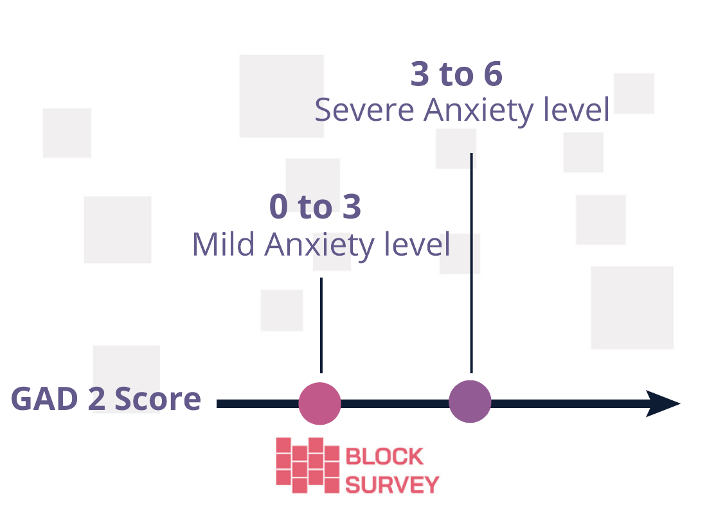
Notes:
Anxiety screening by a two-item Generalized Anxiety Disorder(GAD-2) | BlockSurvey

Slide 25
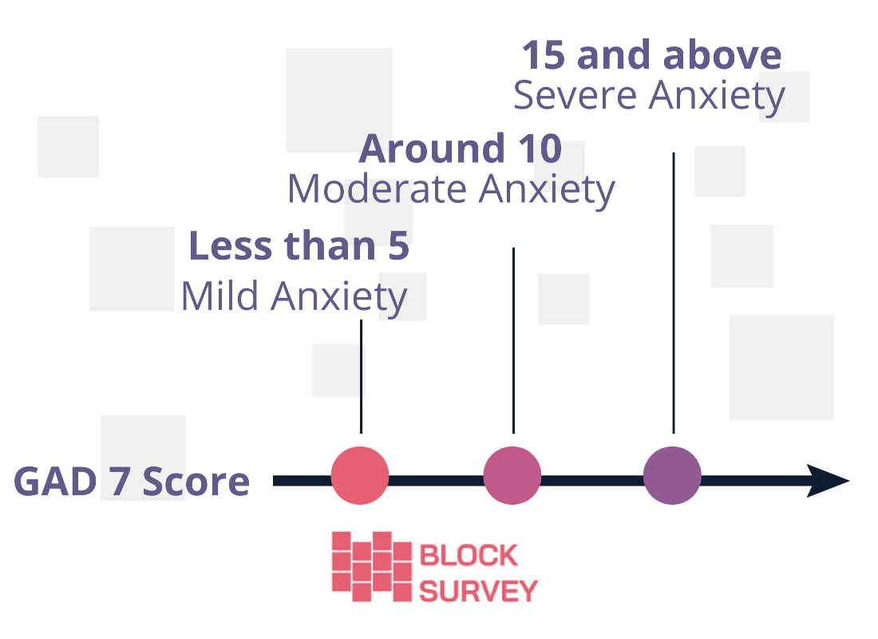
Notes:
Anxiety Screening with 7-question quiz(GAD-7) | BlockSurvey

Slide 26
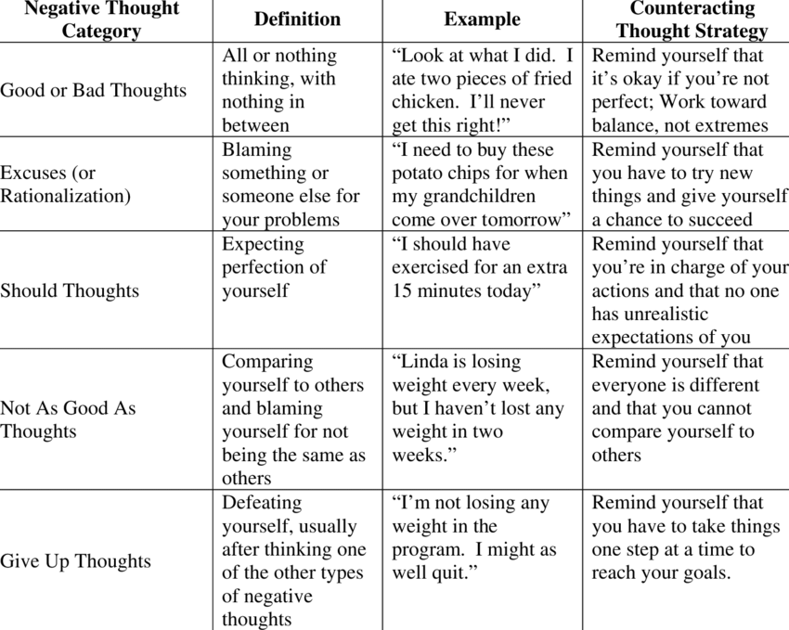

Slide 27
Calmer Life Program Clinician Manual
Program structure
Provided over a three-month period
12 weekly sessions
In-person or Phone sessions

Slide 28
Session Two: Breathing Techniques for Relaxation
Visual examples
https://youtu.be/QRSbxS-uG9A
https://youtu.be/aninPEfbRRw
https://youtu.be/wfDTp2GogaQ

Slide 29
Elective Session: Learn How to Relax II -PMR
Progressive Muscle Relaxation
https://youtu.be/ihO02wUzgkc
Page 55 – Clinical Manual

Slide 30
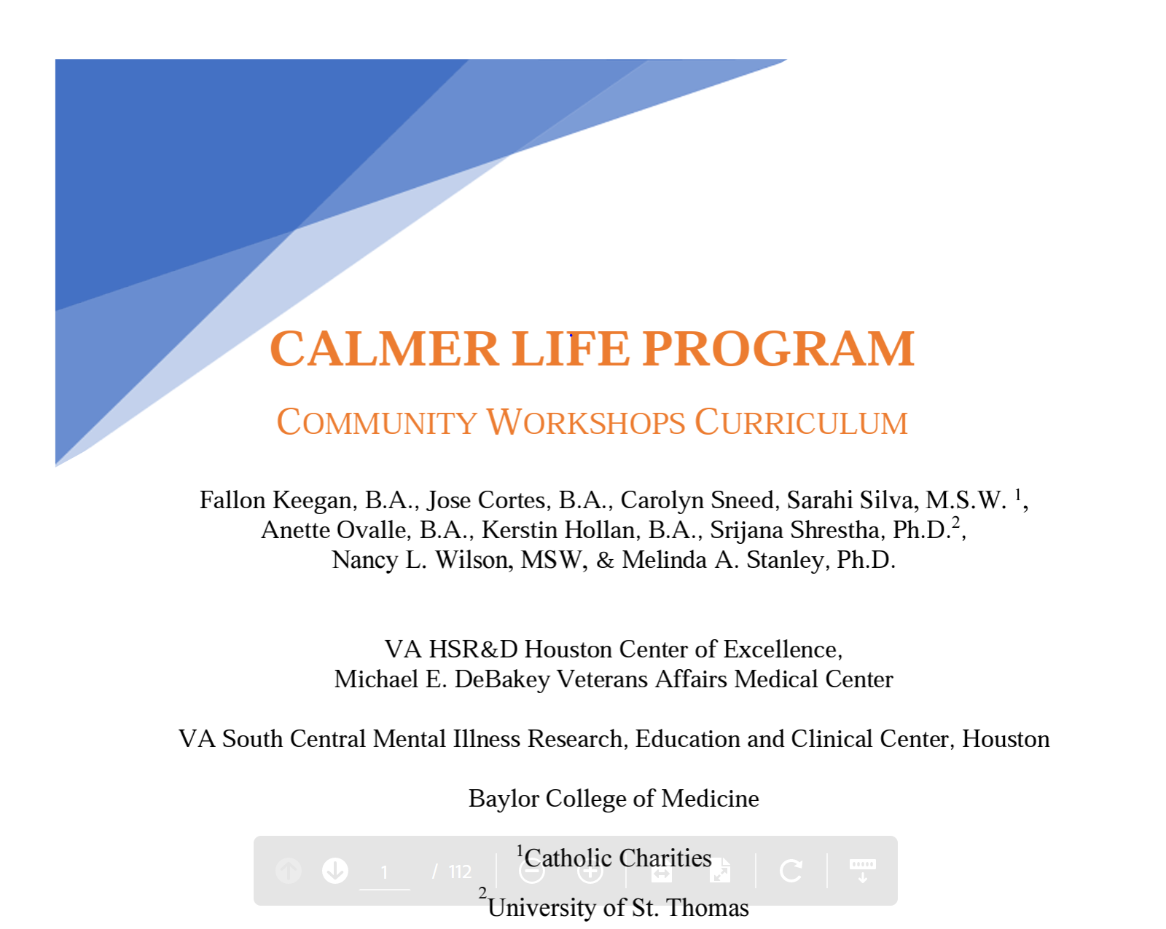
Calmer Life Program Community Workshop Curriculum
Bingo game

Slide 31
Local Resources
Area Agency on Aging of the Coastal Bend - https://aaacoastalbend.org/about-us/

Slide 32
Additional Resources
American Counseling Association and Medicare Mental Health Workforce Coalition - https://www.counseling.org/government-affairs/federal-issues/medicare-mental-health-workforce-coalition
National Coalition on Mental Health and Aging - https://www.ncmha.org/
The Collaborative Care Model - https://www.psychiatry.org/psychiatrists/practice/professional-interests/integrated-care/learn
The Commonwealth Fund - https://www.commonwealthfund.org/publications/issue-briefs/2022/jan/comparing-older-adults-mental-health-needs-and-access-treatment
National Council on Aging and The Older Americans Act (OAA) - https://ncoa.org/advocates/public-policy/issues/aging-services/older-americans-act

