Slide 1
Substance Use Disorder Training
Clinical Manager: Grace Welply, MS, LPC, LCDC

Slide 2
Mission , Vision, and Values
Cenikor. A Place for Change. Providing a Foundation for Better Health and Better Lives.
Cenikor will be a leader in providing quality substance abuse and behavioral health services in the communities we serve through a continuum of care for adults and adolescents.
Health; Wellness; Faith; Work; Recovery; Respect; Accountability; and Education

Slide 3
Key Areas of Focus
Services offered to the community by Cenikor
Substance Use Treatment Overview
Living in Balance : Relapse Prevention
Seeking Safety : A Treatment manual for PTSD and Substance Use Disorder

Slide 4
What Services Cenikor has to offer :
Adolescent Treatment (Odyssey House)
Medically Assisted Treatment
Withdrawal Management (Detox)
Veteran Services
Short Stay Residential
Outpatient
Recovery Housing
Outpatient Services
Recovery Support Services & Alumni Services

Slide 5
Objective:
To educate Counseling students (who are the future) in Substance Use Disorders and Guide through two Evidence Based Manualized Therapies for Substance Use Disorders

Slide 6
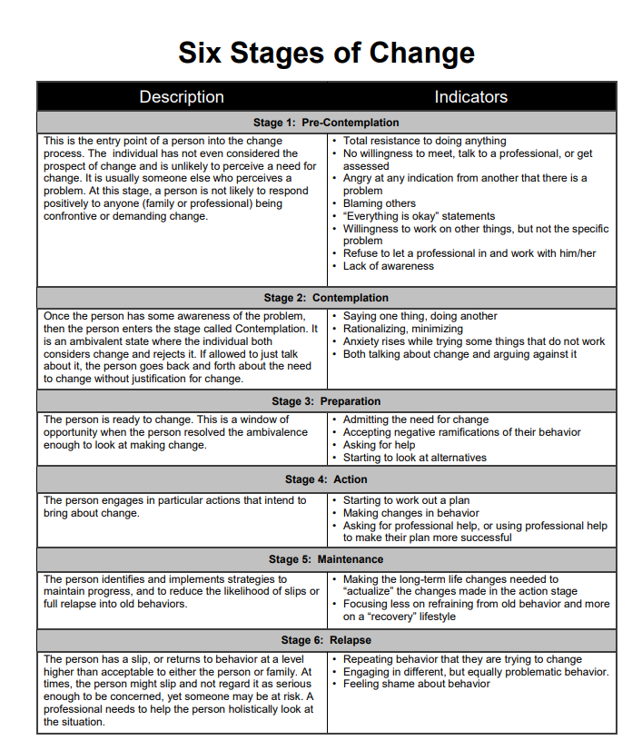
What is addiction ?
An addiction is a chronic brain disease that causing compulsive substance use despite harmful consequences to the individual user.
Initially, the addictive behavior is engaged in because it results in a pleasurable experience.
However, continued engagement becomes compulsive and begins to interfere with ordinary life responsibilities.

Slide 7
DSM-V Criteria -SUD
The DSM-V recognizes substance-related disorders that result from the use of ten separate classes of drugs: alcohol, caffeine, cannabis, hallucinogens (phencyclidine or similarly acting arylcyclohexylamines), other hallucinogens such as LSD, inhalants, opioids, sedatives- hypnotics- or anxiolytics, stimulants (including amphetamine-type substances, cocaine, and other stimulants), tobacco, and other or unknown substances.
These 10 classes are not fully distinct.
All drugs that are taken in excess have in common direct activation of the brain reward system, which is involved in the reinforcement of behaviors and the production of memories.
Drugs produce an intense activation of the reward system that normal activities may be neglected.
Reward pathways are directly activated when abusing drugs instead of achieving reward system activation through adaptive behaviors.
(DSM-5, 2013, p.481)
Substance related disorders are divided into two groups including ten sperate classes of drugs:
Substance use disorders: Patterns of symptoms resulting from the use of a substance that you continue to use, despite experiencing problems as a result . Includes: Alcohol, cannabis, hallucinogens, inhalants, opioids, sedatives, stimulants, tobacco and others except caffeine.
Substance-induced disorders: Intoxication, withdrawal, and other substance / medication-induced mental disorders (psychotic disorders, bipolar and related disorders, depressive/anxiety/obsessive-compulsive/ neurocognitive disorders, sexual dysfunction and delirium)

Slide 8
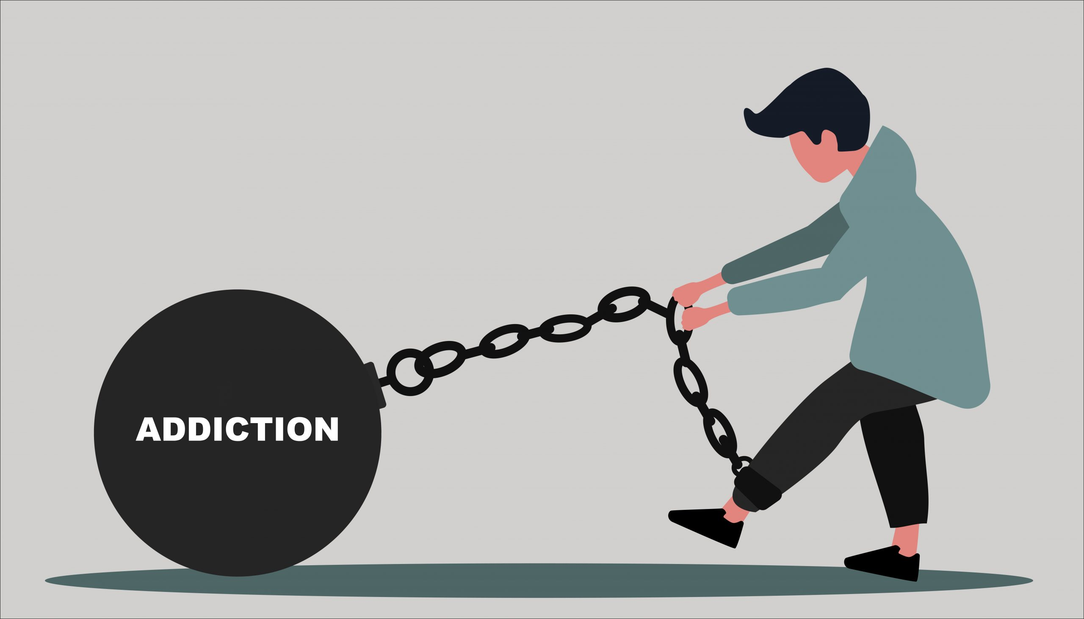
Habit and Addiction…One In the Same?
A habit is done by choice. Individuals can choose to stop a habit and will subsequently be successful in doing so provided they are motivated to do so.
Addictions involve a psychological and physical component not found in habits. These components are often out of the conscious control of the individual, and make stopping a particular activity a challenging endeavor

Slide 9
Time for a video:

Slide 10
Recap of video :
In the video you just saw, addiction was not instantaneous. It was developed over time, and can begin during first ingestion
Gradually, the motivation to ingest the substance changed; going from a want to a need
At this point, both a physiological and psychological addiction occurred

Slide 11
Cycle Of Addiction:

Slide 12
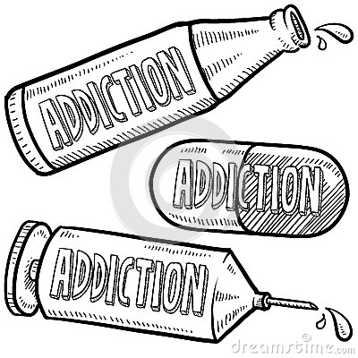
Cycle continued :
When physiological and psychological addiction set in, a pattern develops resulting in increased usage
This self-defeating pattern sees individuals use a substance more frequently, and in greater quantities, than intended because they do not see themselves having a choice in the matter
Usage must continue!

Slide 13
Symptoms of One Disorder May Trigger the Others:
Chronic drug and alcohol abuse increases the chances of becoming a victim of assault or rape. These traumatic events can create serious mental health issues like PTSD, Depression, Eating disorders and more
Poor decision-making is common under the influence, and patients may break the law or make other choices that cause them to struggle with anxiety in addition to drug addiction
Unprotected sex or sharing needles with people infected with HIV or hepatitis C can lead to the contraction of the disease, which in turn can mean a struggle with depression and grief over the life-changing consequences
Depression is a common effect of certain drugs like crystal meth and alcohol as they begin to wear off, and it’s a symptom that can deepen over time
Individuals who suffer from mental illness are more prone to develop an addiction to drugs or alcohol for several reasons. SOME CONDITIONS MAKE SUFFERERS ESPECIALLY PRONE TO DRUG ABUSE!!!
While there are quite a few examples of conditions that are especially likely to be associated with drug addiction, some of the most common conditions to be associated with mental illness are bipolar disorder, depression, anxiety disorders, and schizophrenia. Here’s what you need to know about each condition and how it can make someone more prone to drug abuse
Schizophrenia causes especially severe symptoms, and sometimes drugs and alcohol provide a temporary escape for individuals who suffer from this disorder

Slide 14
HOW MENTAL ILLNESS CAN TRIGGER ADDICTION:
While there are quite a few examples of conditions that are especially likely to be associated with drug addiction, some of the most common conditions to be associated with mental illness are bipolar disorder, depression, anxiety disorders, and schizophrenia. Here’s what you need to know about each condition and how it can make someone more prone to drug abuse
Schizophrenia causes especially severe symptoms, and sometimes drugs and alcohol provide a temporary escape for individuals who suffer from this disorder
People who suffer from anxiety are more likely to abuse alcohol
People who suffer from bipolar disorder are also more prone to alcohol addiction in an attempt to “smooth out” mood swings
However, individuals with bipolar disorder often abuse other substances as well, especially in the manic phase of the condition
Individuals with depression often self-medicate with various substances, and this is especially common in women who have a drug addiction

Slide 15
Self-Medicating:
Self-medicating is a term that many people use to describe their use of substances as a way of coping with difficult emotional or mental states. It is not uncommon for those experiencing symptoms of mental health disorders to report that they initially tried to deal with their anxiety, mood disorder or psychosis by “self-medicating” with alcohol or drugs
The National Alliance on Mental Illness reported that 50 percent of individuals with severe mental health disorders are affected by substance use. In addition, 37 percent of alcohol users and 53% of drug abusers also have at least one serious mental illness

Slide 16
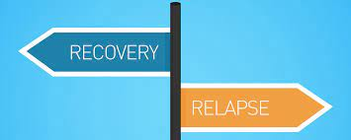
Living in Balance : Relapse Prevention
In the Relapse Prevention session, clients will review ways in which triggers can lead to relapse, different types of triggers, and techniques they can use to avoid and defuse triggers. Because triggers are personal and can be emotional issues, reviewing this information may be challenging. However, working through this session is important because it can teach you one of the most important skills that you will need for your recovery, which is stopping triggers from leading to relapse

Slide 17
Relapse Prevention Basics:

Slide 18
Triggers:

Slide 19
Interventions/Strategies
Identifying the negative consequences of the clients drug abuse along with gathering a complete drug/alcohol history which would include: the amount, the pattern of usage, and the negative social, family, legal, and vocational life consequences
Cognitive-Behavioral is based on the Psychoeducational Model, which makes use of homework along with placing responsibility on the client to assume a new active role (Motlagh, & Ibrahim, & Menke, Rashid, & Seghatoleslam & Habil, 2016).

Slide 20
Seeking Safety : A Treatment manual for PTSD and Substance Use Disorder
Lessons :
Asking for Help
Taking back your power
When substances control you
Healthy boundaries in relationships
Commitment
Detaching from emotion pain (Grounding)

Slide 21
Session formats :

Slide 22
THANK YOU FOR
YOUR TIME AND
CONSIDERATION.
My Favorite Quote
"One small crack does not mean that you are broken, it means that you were put to the test and you didn't fall apart. " — Linda Poindexter

Slide 23
References :
Chapter 448 Substance Abuse Standards of Care Rules
American Psychiatric Association. (2013). Diagnostic and statistical manual of mental disorders (5th ed.). Washington, DC
Maisto, S. A., & Galizio, M, &Connors. (2015). Drug Use & Abuse (7th ed). Stamford, CT: Cengage Learning.
https://www.nami.org/
https://www.samhsa.gov/
Woolis, Rebecca. (1992, 2003) When Someone You Love Has a Mental Illness, New York, New York. Penguin Group.

