Slide 1

FAMIS ACCOUNTS
Maria E Alaffa
Christy Robertson

Slide 2


Table of Contents
Chart of Accounts
  Account Structure
New Account Request
  Form (Now on Smartsheet!)
  Guidelines
Year End Flags
Encumbrances
Global Sub-code Edits
Generate Expense Budget
Closing Accounts
  When
  What to look for
  Banner Reversals
  Q&A

Slide 3
Chart of accounts
G/L Account Range S/L Account Range **Fund Group
010000-019999 100000-199999 State Funding
020000-029999 200000-299999 Designated Funds
030000-039999 300000-399999 Auxiliary Funds
040000-049999 400000-499999 Scholarship Funds
050000-069999 500000-699999 Grants & Contracts
070000-079999 No SL Accts Loans & Endowments
080000-089999 800000-899999 Plant Funds
090000-099999 900000-999999 Agency & Fiduciary Funds
** For fund source information refer to Section 02.03 in Finance Handbook

Slide 4

Chart of Accounts CONT.
FINANCE HANDBOOK
Section 03.01
https://www.tamucc.edu/finance-and-administration/financial-services/accounting/finance-handbook.php

Slide 5

New Account Request form now online!
FINANCE HANDBOOK
SECTION 02.02 Link:
https://www.tamucc.edu/finance-and-administration/financial-services/accounting/handbook-documents/section-02-02.pdf
Accounting Services-Online Forms Link:
https://www.tamucc.edu/finance-and-administration/financial-services/accounting/forms.php

Slide 6
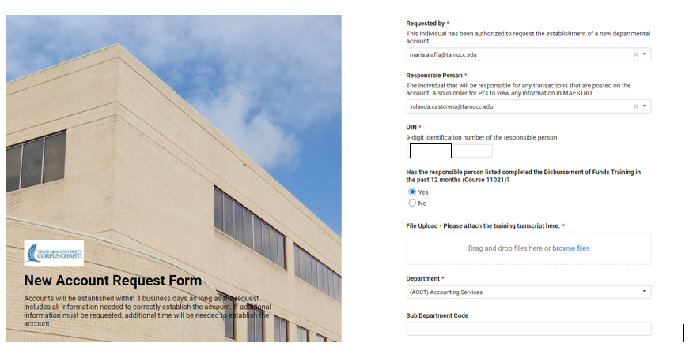
New account request
Requested by (*Required)- This individual has been authorized to request the establishment of a new department account. Email will be used to send notification once NAR is processed.
Responsible Person & UIN (*Required)- A responsible person must be a permanent PT or FT employee who is compensated by TAMU-CC University. In most cases this will be the Department Head. The responsible person must have completed Disbursement of Funds Training within the last 12 Months. A copy of the training transcript is required (Course# 11021:Disbursement of Funds)
Department (*Required)& Sub Department – Select the department from the drop-down menu & sub department if applicable. If your department is not listed as an option, please email Accounting at accounting.services@tamucc.edu

Slide 7

New account request
Account Short Name (*Required)- Enter the name you would like displayed for the account. Character limit on account name is limited to 35 characters. The title will need to correspond to the purpose of the account.
Account Long Name- If applicable.
Account number requested-no dash needed (optional)
Account Purpose (*Required)- Detailed information of the purpose of the account will help determine the true function of the account. Detailed description required, including source of funds. If available, please attach documentation.
Source of Funds (*Required)- FINANCE HANDBOOK SECTION 02.05
  AGENCY FUNDS
  AGREEMENTS
  CONTRACTS
  DESIGNATED TUITION
  GRANTS
  COMPREHENSIVE RESEARCH FUNDS
  RESEARCH ENHANCEMENT FUNDS
  STATE APPROPRIATIONS
  STUDENT FEES
  OTHER

Slide 8
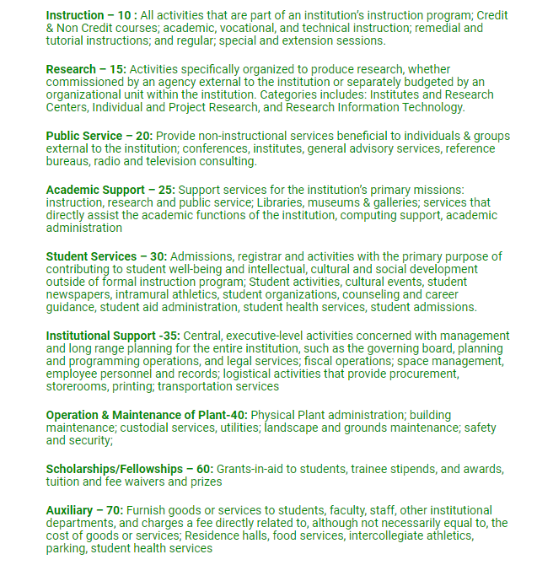

FINANCE HANDBOOK SECTION 02.04
Use of Funds (*Required)- Select the function that will best classify what the funds will be spent on. Determination of the function code is very important in coding of account for reporting purposes.
  “Will a list of functions and their descriptions assist in determining the best use of funds?”

Slide 9
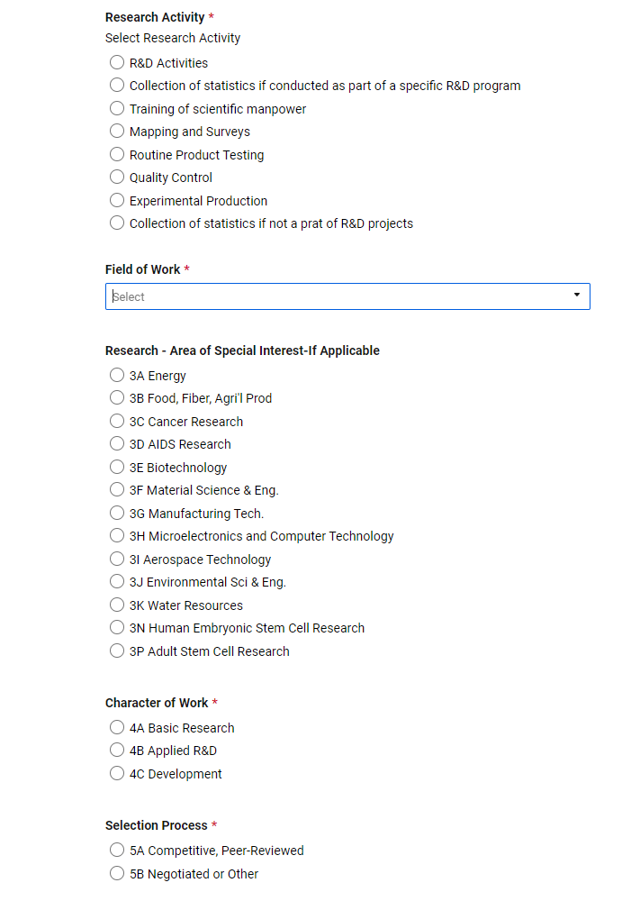
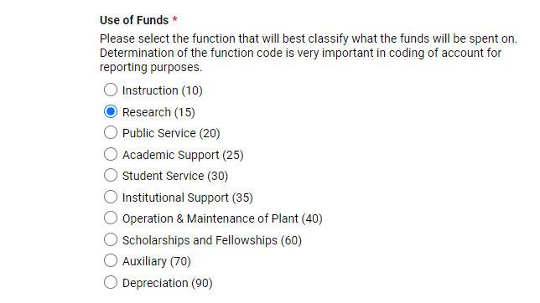


Research Accounts
  FAMIS: Screen 9 for SL or Screen 59 for Support Accounts
  Canopy: FRS Account Attributes

Slide 10

Salary Savings
Salary Savings Distribution? (*Required)
  Salary Savings– are the monies remaining from a vacant position after all payroll and termination costs have been satisfied. The types of positions that generate attrition are faculty professional, faculty administrator and classified positions.
Some examples of how salary savings funds are generated include:
1. savings from positions being vacant for long periods of time
2. savings when a member of the faculty or staff goes on leave without pay status.

Slide 11

New account request cont.
Any restrictions on funds ?
At termination of the account, what provisions for deficits or refunds of the balance are to be made?
What is the provision for retaining title to equipment purchased with these funds?

Slide 12
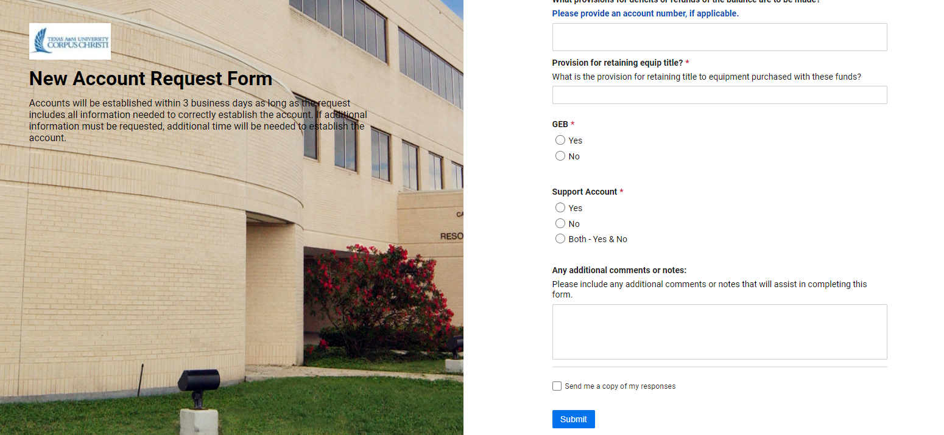
Budget & Support Accounts
Budget Flexible (GEB) - A flexible budget is a budget that adjusts or flexes for changes in the volume of activity.

Slide 13
Support Accounts
What is a support account? – Sub-division of Subsidiary Ledger accounts used to track account activity at a lower level. By creating a support account this enables the department to keep better track of the funds.
300090-00000
Stadium Revenue Fund
10000 20000 30000
Men’s Golf Women’s Golf Men’s Tennis

Slide 14
Support accounts
You can divide the SL money up between your Support Accounts.
300090-00000 $9000
Stadium Revenue Fund
10000 $3,000 20000 $3,000 30000 $3,000
Men’s Golf Women’s Golf Men’s Tennis

Slide 15

SA TRANSACTIONS
“N” No transactions allowed on Support Account
“Y” Yes transactions are allowed on Support Account.
“B” Transactions allowed on both the Base account and Support Account.
You can view these flags in Canopy by clicking on the FRS Tab then using the drop down menu to click on Account and then clicking on Attributes.

Slide 16

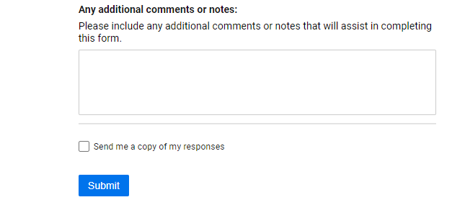
New account request cont.

Slide 17

Year end flagS
Year End Flags
  E = Encumbrances Only
  T = Transfer BBA
  F = Fiscal Year
  P = Project Year
  Determined by the source of funds of the account
  Indicates how balances in the account will be treated at year end
  Can be found on the attribute module in Canopy and Screen 06 in FAMIS
  https://www.tamucc.edu/finance-and-administration/financial-services/accounting/handbook-documents/section-17.01.pdf

Slide 18
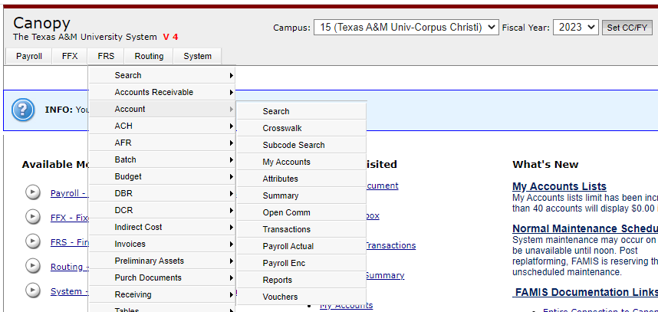
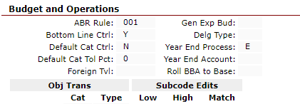
Year end flag - canopy

Slide 19
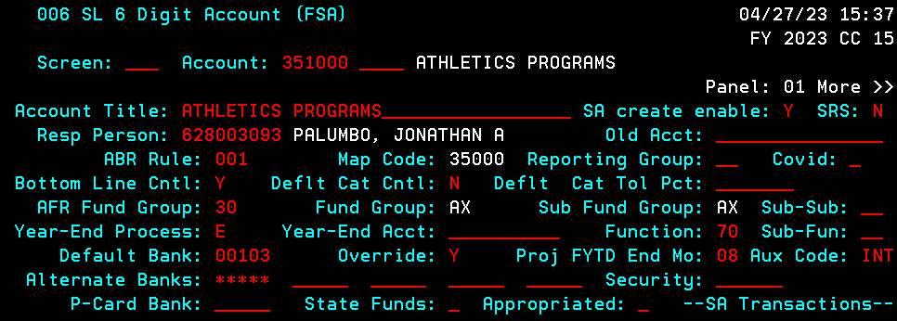
Year end flag - FAMIS

Slide 20
Year End Flag - Encumbrance
E – Encumbrances Only
  Carries forward only encumbrances and budget to cover those encumbrances
  Rolls forward on Batch Reference of BBFE (Budget Brought Forward Encumbrance)
  Only certain object codes will roll forward
    For example: Office supplies will not roll forward
    Procurement & Disbursements can assist with codes that will and will not roll forward
  Example – State Account

Slide 21

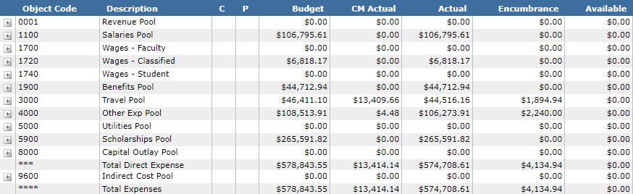
Year end flag - Encumbrance
E-Encumbrance
  FRS Account Summary

Slide 22
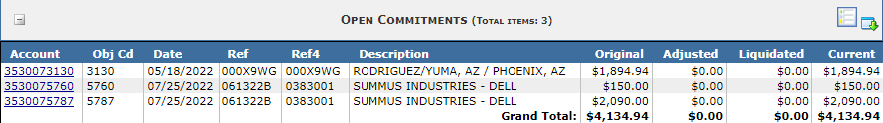
Year End Flag
Open Commitment Screen at Year end FY2022
  FRS Account Open Commitment
Example of Budget and Encumbrance rolling forward to cover encumbrance in FY2023 on transaction tab
  FRS Account Transactions

Slide 23
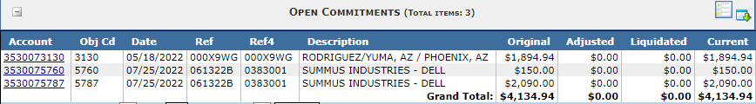
ENCUMBRANCES
Example of encumbrance rolling forward to new year and paid
  FRS Account Open Commitment
  FRS Account Transactions
Notes:
Now let’s follow a couple of encumbrances through to payment….

Slide 24

Year end flags
T – Transfer
  Only carries forward encumbrances and budget to cover those encumbrances
    Rolls forward on Batch Reference of BBFE
  Any remaining balance at year end will be transferred to another account
    Account specified on attribute module in canopy and screen 006 in FAMIS in field “year-end account”
      Designated tuition and some indirect accounts

Slide 25
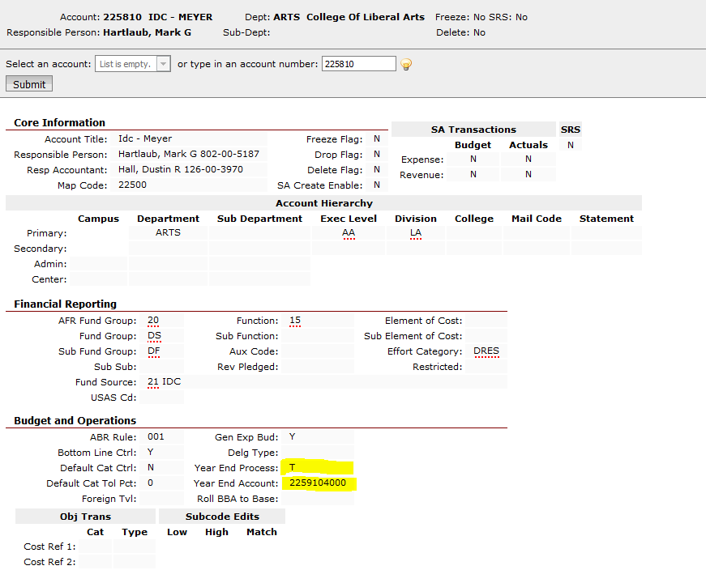
Year end flag – transfer
FRS Account Attributes
Notes:
Account 225810

Slide 26
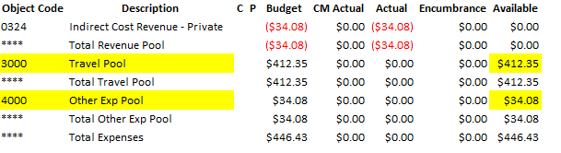
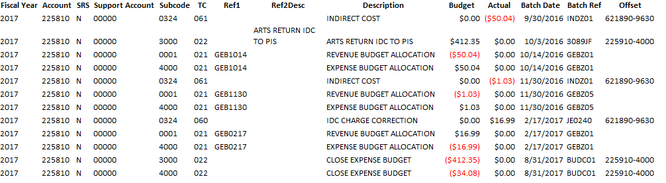
Year end flags - transfer
FRS Account Summary
FRS Account Transactions

Slide 27
Year End Flag - Fiscal
  F - Fiscal Year
  Carries forward all unexpended balances including encumbrances, revenue and expense budget
  Creates a Batch Reference
    BBFE (Budget Brought Forward Encumbrance)
    BBF (Budget Brought Forward) for all BBA
  Local accounts – gift and material fee accounts

Slide 28
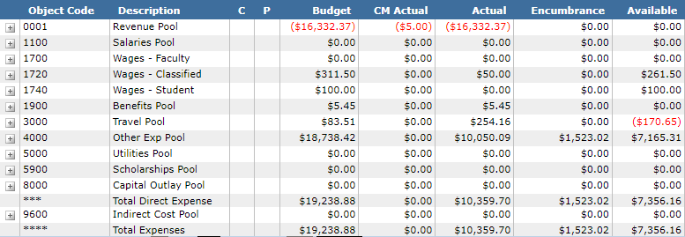
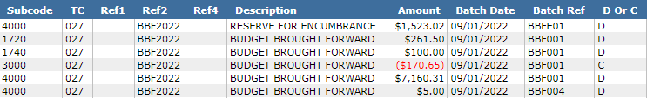
Year End Flag - Fiscal
Available Balances Year End FY2022 –
FRS Account Summary
BBF FY2023
FRS Account Transactions
Notes:
650420

Slide 29

Year end flag - Project
P-Project Accounts
  Carry forward all balances
    Including encumbrances, revenue and expense budget and actuals
  Creates a Batch Reference
    BBFE (Budget Brought Forward Encumbrance)
    BBPJ (Budget Brought Forward Project)
    BBPA (Beginning Balance Project Actuals)
  Can Retrieve totals from inception
  Grant and Contract Accounts

Slide 30
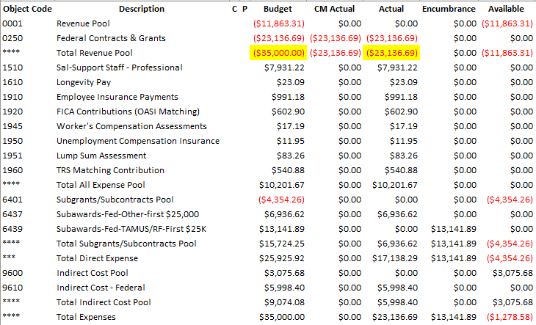
Year end flag - project
Year Ending Project Actuals
FRS Account Summary

Slide 31
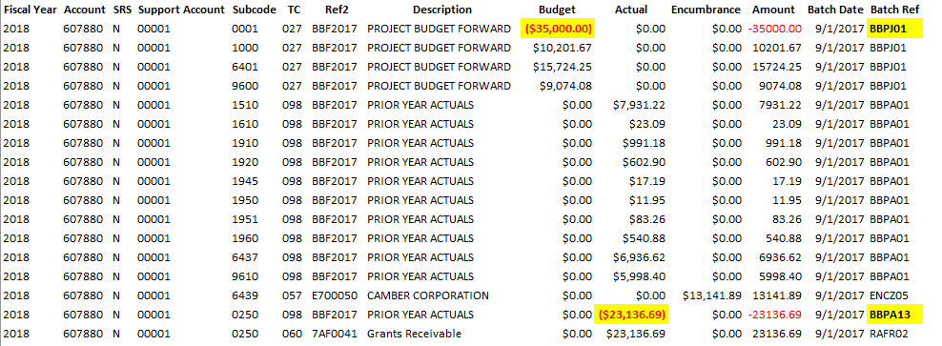
Year End Flag - Project
FY Beginning Balances
FRS Account Transactions

Slide 32
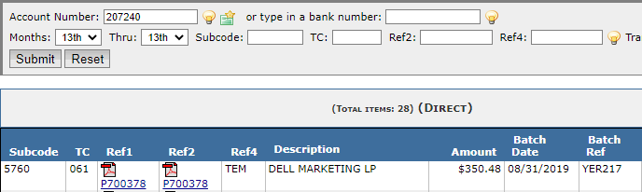
Year end accruals
Receiving has been done by each department but item has not paid
YER217 job created to book accrual
Once it posts it creates a reversing entry in the new year on a batch reference of RYR217.
FRS Account Transactions
Notes:
This is another reason why it’s good to meet the purchasing YE deadlines. Helps cut down on this situation.

Slide 33

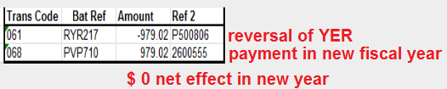

Example of YER217 batch being reversed in the new year and paid.
FRS Account Transactions
Notes:
Point out t codes – 5s are encumbrances

Slide 34

Global sub-code edit
Global Sub-code Edit – Determines allowable and non-allowable sub- codes specific to certain types of accounts.
  Screen 803 in FAMIS is a Sub-code Edit Table that displays standard restrictions and non restrictions applicable to certain types of accounts.
    The low and High sub-code fields define a specific range that will either be allowable or not allowable for the account listed in “Mask of Account field”.
      Y – indicates that the sub-code or sub-code range is allowable.
      N- indicates that the sub-code or sub-code range is not allowable.
  Screen 008 in FAMIS allows you to place a sub-code edit specific to an account that normally would allow or disallow certain sub-codes.

Slide 35
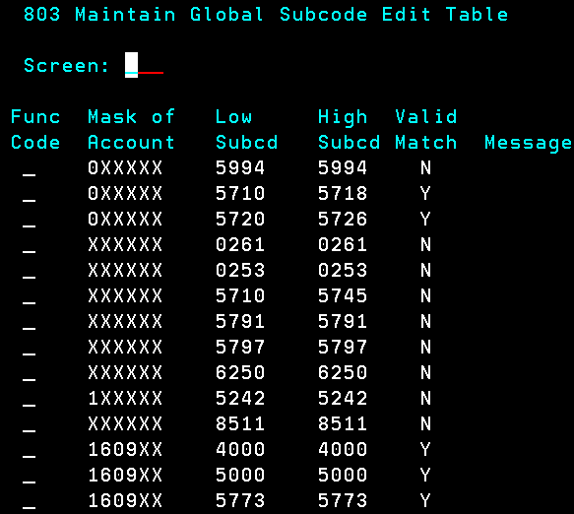
Global sub-code edit

Slide 36
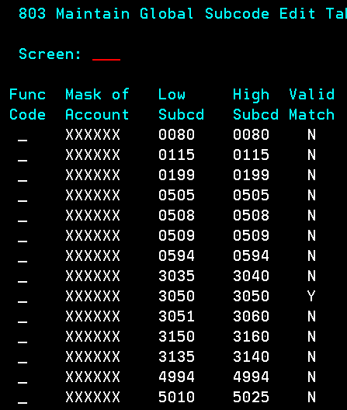
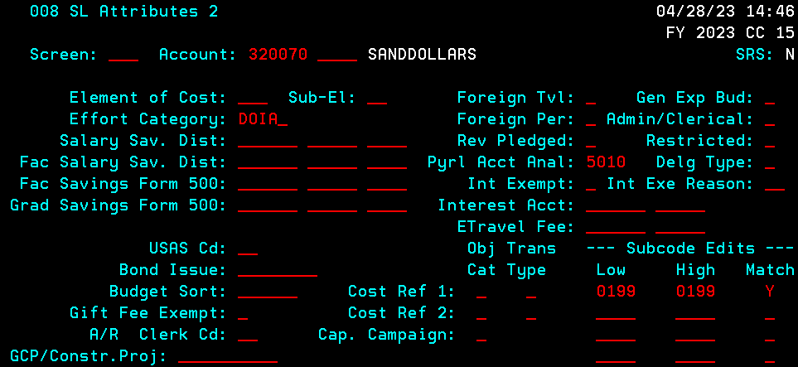
Global sub-code edit
Screen 008 sub-code edit is an exception to the rule and has to be approved by Assistant Controller.

Slide 37
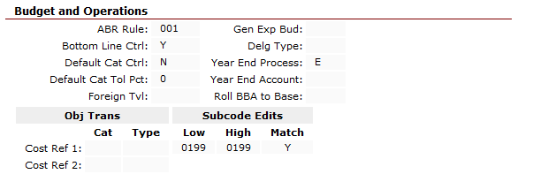
Sub Code Edit – Account Level
FRS Account Attributes

Slide 38

Generate expense budget (GEB)
Generates Revenue and Expense Budget (GEBZ)
Self Funding
Can only spend revenue received
Examples
  Indirect Cost Accounts
  Summer Camp Accounts
  Residual Accounts

Slide 39
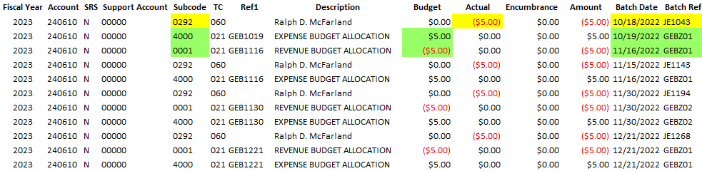
Generate Expense Budget (GEB)
GEB Account
FRS Account Transactions
Notes:
Excel version

Slide 40
Closing accounts
Account Balances
  GL/SL Balances
  Fund Balance
  Receivables and Payables
  Any Support Accounts must have $0 balance
Request for Closure
  If there have been NO transactions during the FY, the account can be dropped immediately.
  Otherwise, the account will be frozen and dropped at year-end.

Slide 41
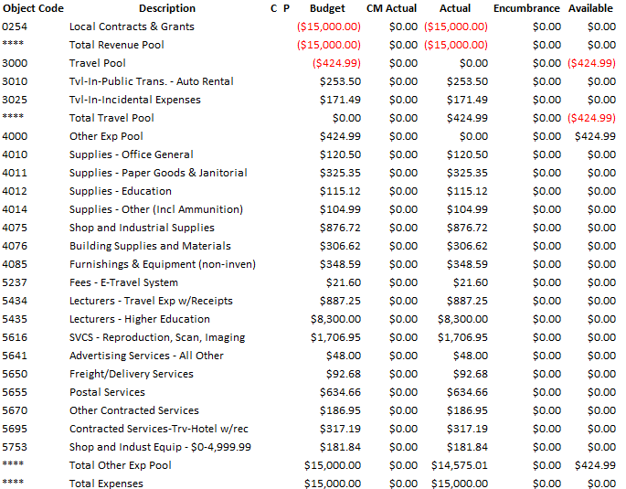
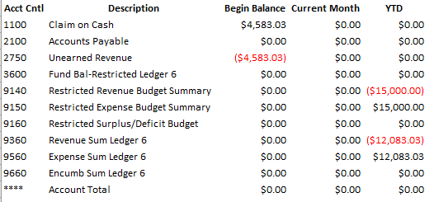

Account Ready For Close
S/L Account
G/L Account
FRS Account Summary

Slide 42
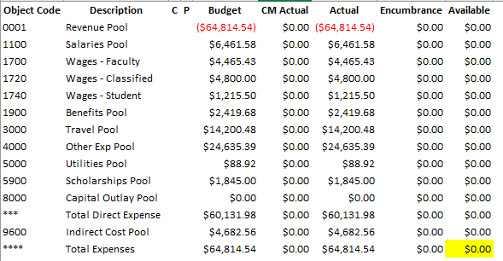
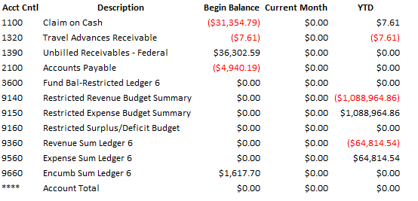

Account Not Ready for Closure
S/L Balance
G/L Balance
FRS Account Summary

Slide 43
Banner reversals
Banner reversals are generated to ensure tuition payments are recorded in the proper year.
  Registration for the fall semester occurs during the period April – August of the current year. The payments are not recorded in Famis until the Bursar Office calculates billing for the fall term.
  Billing calculations are normally done in July and August and post to an account in Famis on a batch reference (BNR001), with a description “Banner Load.”
    These batches can include corrections to summer billing and payments for summer tuition .
  A JE is prepared to defer revenue collected for the fall semester because it is unearned revenue. There can be several throughout the month of July and August. Not allowed to make AFR entries at this time.

Slide 44
Banner reversals
  Year end reversing Entries
    At year end an entry is made to reverse out the JE’s prepared to defer revenue and create a corresponding AFR entry.
    The corresponding AFR entry is prepared entitled Banner Reversal to reverse the total tuition payments received for fall tuition and post them in September of the new year. This will be on a batch reference (AFRXXX).

Slide 45

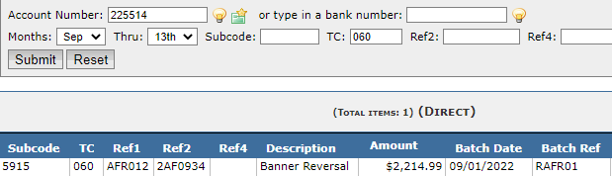
BANNER TRANSACTIONS
Banner Load-Billing Calculations
August Deferred Revenue (AFR entry can’t be done at this time)
Reverse August Deferred Revenue
Post reversal in an AFR entry to reverse Banner load (BNR001)
FRS Account Transactions
Notes:
Finish this one

Slide 46


Any questions?

Slide 47


