Slide 1
TAMUCC HUB Subcontracting Plan Brief:

Slide 2
HUB Subcontracting Plan (HSP)?
When the value of a purchase order or contract is expected to be $100,000 or greater, a HUB Subcontracting Plan is required by the State of Texas
Note: FY 2025 TAMU-CC HSP is now available

Slide 3
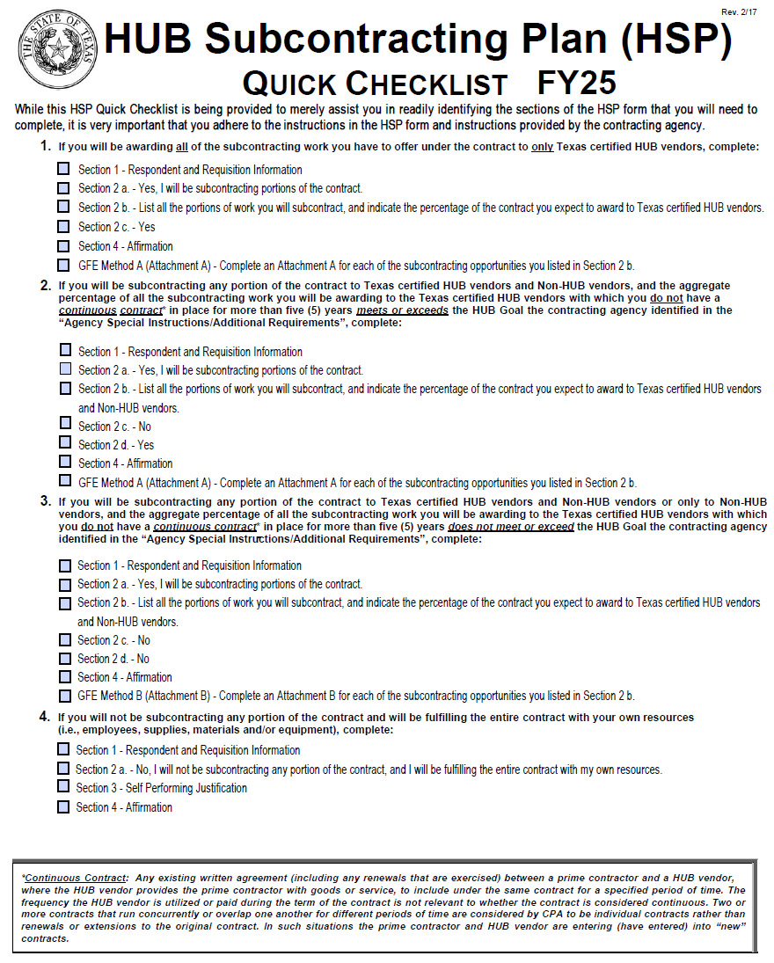
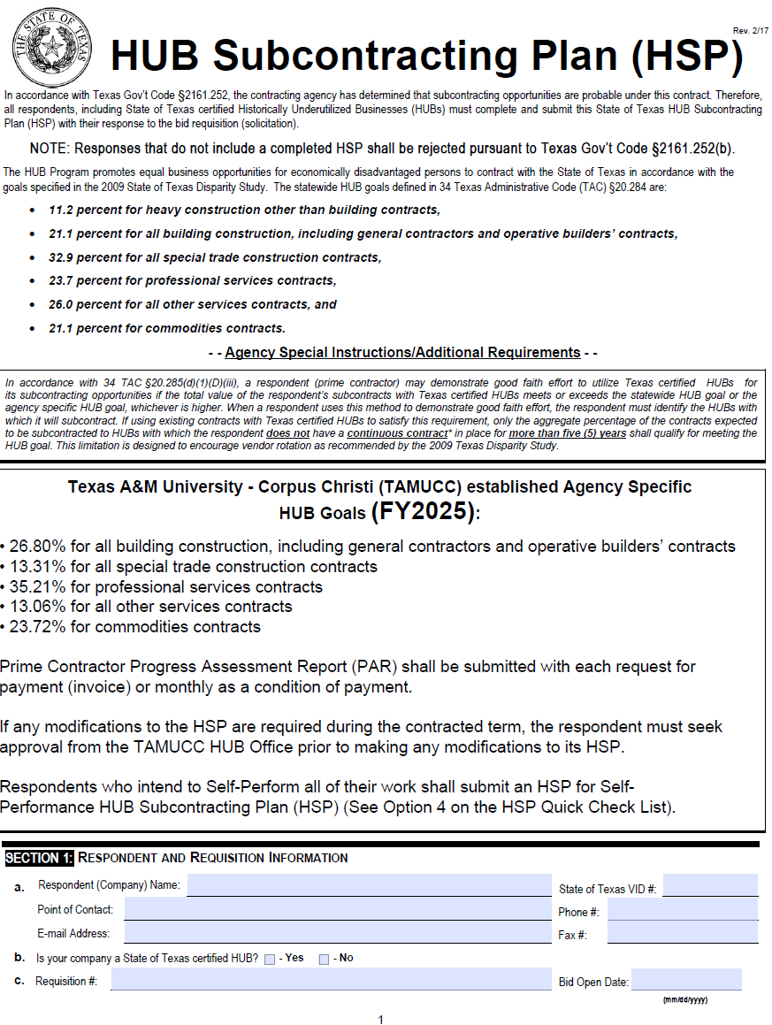
TAMU-CC HUB Subcontracting Plan (HSP)

Slide 4
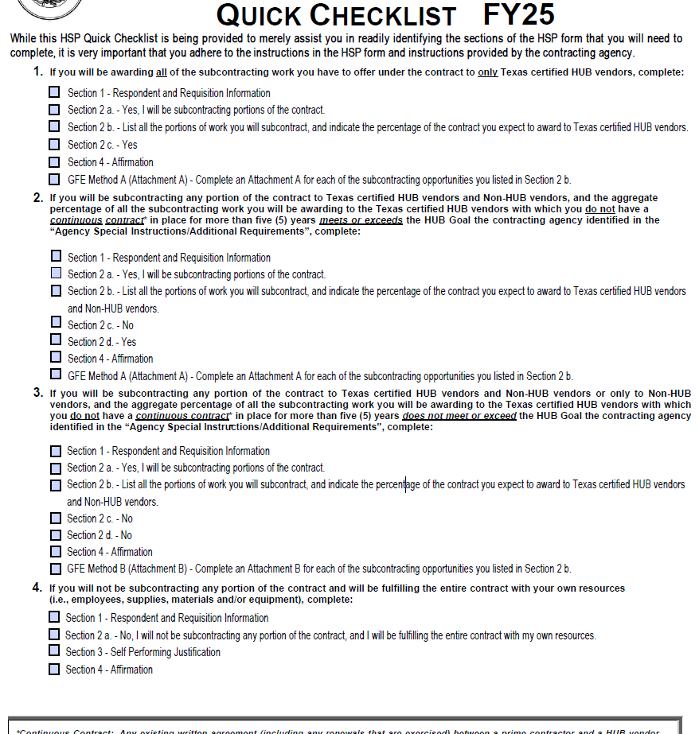
HSP Quick Checklist
Using only HUBs, for all subcontracting listed
Using Subs (HUB & Non)
Meets/Exceeds TAMUCC HUB Goals
Using Subs (HUB & Non)
Does Not Meet/Exceed TAMUCC HUB Goals
Self-Performing: using own resources

Slide 5
TAMU-CC HUB Program
Good Faith Effort Requirement Methods:
Utilizing 100% HUBs for Subcontracting (Attachment A)
Meeting or Exceeding a HUB Goal (Attachment A)
Solicitation (Attachment B)

Slide 6
HUB Subcontracting Plan (HSP) Prime Contractor Progress Assessment Report (PAR)
Prime Contractors
Prime Contractor Progress Assessment Report (PAR) shall be submitted with each request for payment (invoice) or monthly as a condition of payment.

Slide 7
Purpose of a HUB Subcontracting Plan
Identify Subcontracting Opportunities
Document Subcontracting Opportunities
To show “Good Faith Effort”
Per Texas Government Code §2161.252

Slide 8
Things to remember about TAMU-CC HUB Subcontracting Plans
Only required by TAMU-CC when the value of a purchase order or contract is expected to be $100,000 or greater including renewals and amendments
Use the HSP Quick Checklist as a navigation tool, not all pages of the HSP will need to be filled out
Seek approval from TAMU-CC HUB Office if HSP needs to be modified before any changes can be made
PARs will be required as a condition for payment

