Slide 1

FERPA: PROTECTING EDUCATIONAL RECORDS
Family Educational Rights and Privacy Act (1974)

Slide 2
What is FERPA?
Family Educational Rights and Privacy Act is a federal law protecting the privacy of student education records.
At the age of 18, or when the student enters an institution of higher education, all FERPA rights are transferred to the student.
FERPA applies to all educational institutions that receive funds under any program of the U.S. Department of Education.

Slide 3
BASIC PRINCIPLES
Student educational records are considered confidential and may not be released without written consent of the student. FERPA rights begin when a student registers for or attends their first class, not when they are admitted.
As an employee of the A&M system, you have a responsibility to protect educational records in your possession. You should only access educational records for legitimate use in completion of your responsibilites.
You should not access records of any other person or yourself, if you are or were a student, at any time for personal viewing.
It should be noted that records of Dual Credit students who are enrolled in college level courses are protected under FERPA and neither their parents nor high school officials have rights to their records unless explicit consent is provided by the student.

Slide 4
WHAT IS legitimate educational USE?
Use by a school official (authorized employee) performing a task related to a student’s education including any one of the following reasons:
The task is specified in the employee’s position description or by contractual agreement;
The task is related to the discipline of a student;
The employee is providing a service or benefit relating to the student; or
The task is in response to a judicial order or legally issued subpoena. Either of these will be issued to the University Registrar's Office and we will contact you directly if records are needed.

Slide 5

What is an education record?
Anything personally identifiable to the student
Any record maintained by the institution
Examples include class papers, tests, grades, progress reports, class schedules, written notes

Slide 6


Consent Prior to Disclosure
Students may opt to release their information to others, such as parents, family members, or some other third parties. The written consent called a FERPA Waiver must:
Be received by the Office of the University Registrar.
Identify the party to whom the disclosure may be made.
University Staff must verify that:
The notation of FERPA release waiver is specified in Banner or in Starfish.
Contact the Office of the University Registrar for verification.

Slide 7
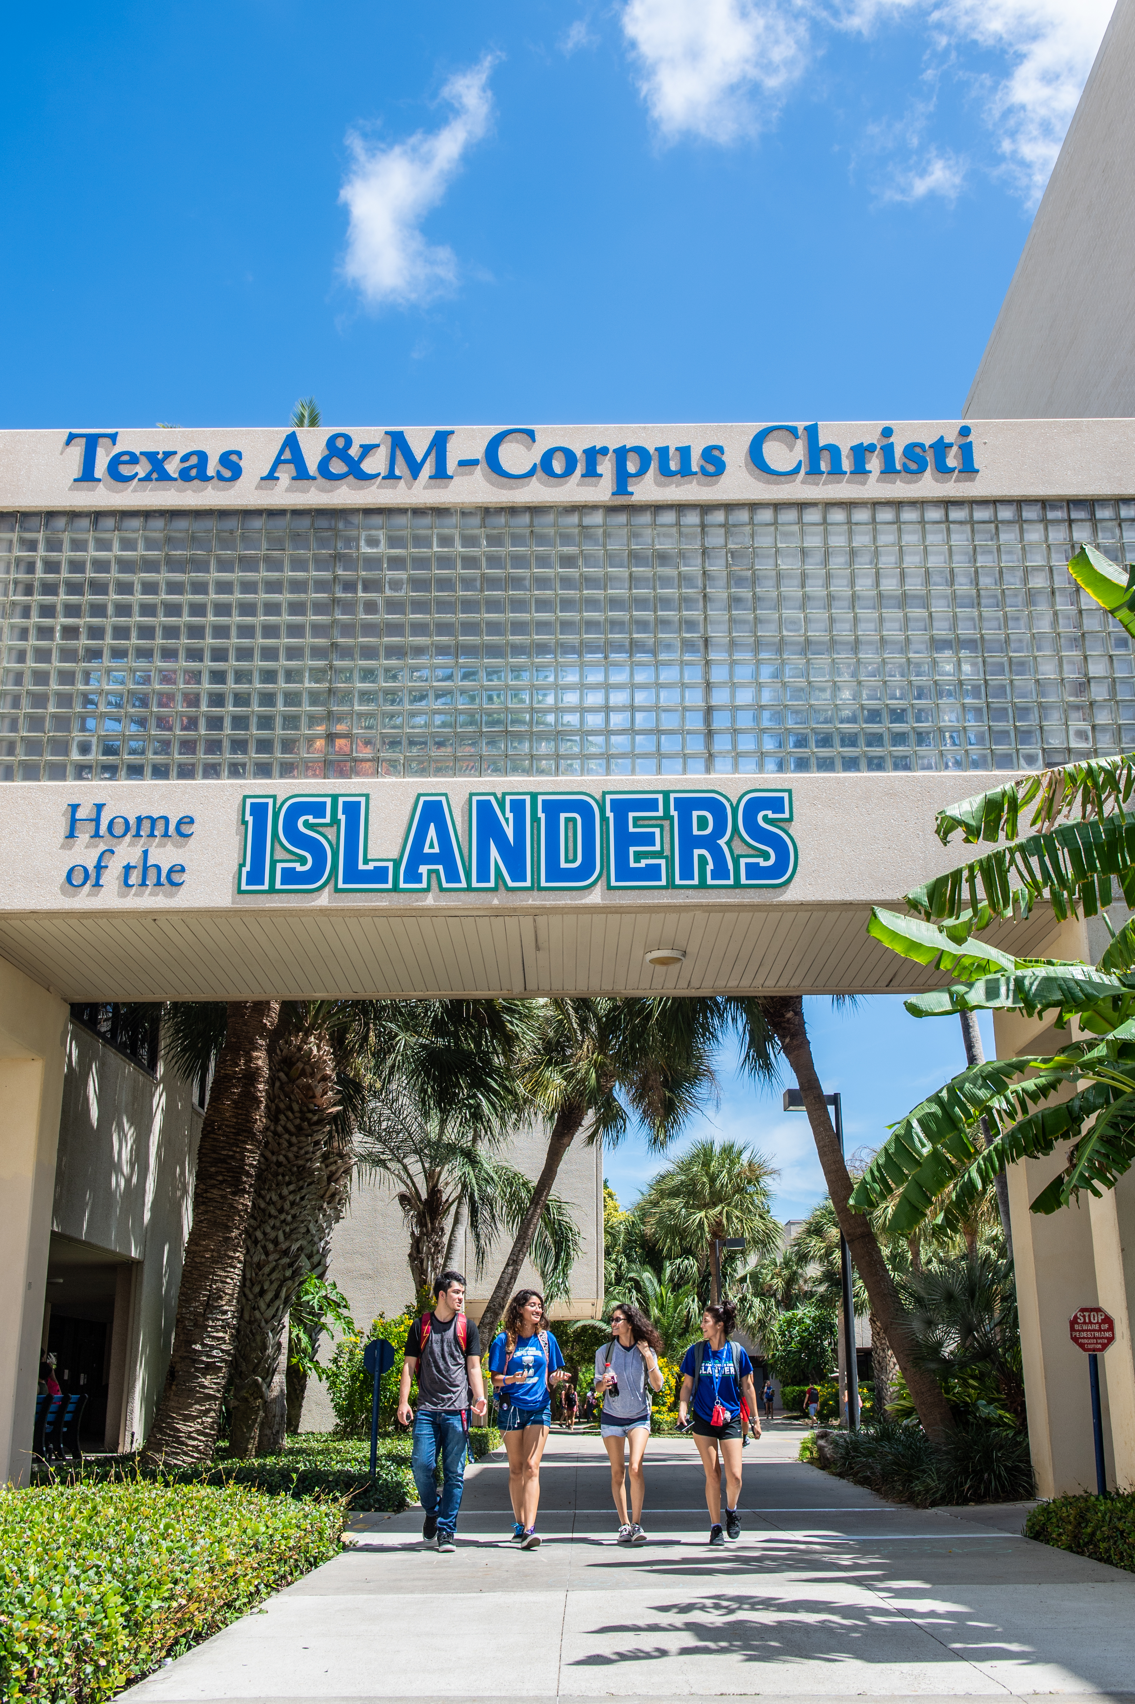
DIRECTORY INFORMATION
FERPA identifies certain information, called directory information, that may be disclosed without the student's permission.
Please visit our website on Directory Information for more information: https://www.tamucc.edu/academics/registrar/ferpa/directory-information.php
All incoming requests for directory information or Public Information Requests should be routed to the Office of Open Records. https://www.tamucc.edu/about-us/open-records.php

Slide 8

Student Rights and Consent
Current and former students have the following rights:
Annual notification of FERPA rights, sent every Fall term;
Right to inspect and review their records within 45 days of the request.
Right to request changes;
Right to consent disclosures;
Right to complain internally via the Office of Information Security and University Registrar; and
Right to complain to the US Department of Education.

Slide 9




Helpful info
When requesting access to university programs that provide student data such as Banner, Laserfiche or Argos:
  Be mindful of the level of access that is being requested. A supervisor usually has a higher level of access than a subordinate. Copying access of a supervisor to subordinates is not recommended.
  If you are granted access to folders that are not related to your job duties, do not run reports. Speak to your supervisor about the excess access, limiting access prevents accidental data exposure.
  When running reports on a student or a group of students and saving it to your desktop, it is helpful to password protect your reports. This prevents anyone from accessing it if you accidentally attach and send it in an email.
  When communicating to students about educational information, refrain from using or responding to personal email addresses. Only utilize their Islander email accounts. If a secondary email address is copied, please drop that email account from your response.
  A FERPA violation puts the university at risk of losing our Title IV federal funding. A penalty for a violation can be withdrawal of U.S. Department of Education funds from the institution.

Slide 10
Banner Pledge of Responsibility
Your Pledge of Responsibility for using Banner as data concerning students is extremely confidential & must be protected from unauthorized use, disclosure and modification. Please read the following pledges carefully.
► I will use only my assigned credentials & will not provide them to anyone.
► I will follow FERPA regulations & use Banner data for legitimate University
business reasons associated with my job function.
► I will obtain my supervisor’s authorization prior to making copies or storing
data on encrypted devices owned by the University.
► I will not modify any data associated with me, a close friend and/or relative.
► I have read & will follow all University Policies and Procedures with regards
to information security and privacy (ITSAU/ITSOC) and my training is up to date.
► If I know or reasonably believe that another person has violated any of the
previous pledges, I will report such suspected violation to the Office of
Information Security at (361) 825-8888 or ois@tamucc.edu.
► I understand that violating any of the following pledges can lead to disciplinary
action, up to and including termination.
► By clicking the button labeled “I accept the Terms of Usage” I acknowledge
I fully understand and agree to abide by the pledges above.

Slide 11


FINAL THOUGHTS FROM THE REGISTRAR
To report a known FERPA violation please contact: OIS@tamucc.edu and Missy.Chapa@tamucc.edu
Wise words to follow:
  When In Doubt, Don’t Give It Out
  Do they really need to know?
  Do I really need to save this report?
Please visit our websites for more information:
  FERPA Essentials for Faculty/Staff https://www.tamucc.edu/academics/registrar/ferpa/faculty-essentials.php
  FERPA Essentials for Parents: https://www.tamucc.edu/academics/registrar/ferpa/parent-essentials.php
  16.01.02.C1 Protection of Educational Records and Personally Identifiable Information
  https://www.tamucc.edu/governance/rules-procedures/assets/16.01.02.c1-protection-of-educational-records.pdf

Slide 12


Questions?
Please contact us with any general questions or concerns:
  registrar@tamucc.edu or
  361-825-7245(SAIL)

