Slide 1

The EPIC Guide to Research Compliance
A Discussion about IRB, DCB, IBC, and IACUC
Janet Donaldson, Associate Vice President for Research and Professor of Microbiology
John Scarpa, IBC/IACUC Coordinator
Larry Lloyd, Dive Safety Officer
Michael Sollitto, IRB Chair and Associate Professor of Communication
Patrick Larkin, IBC Chair and Associate Professor of Chemistry
Wei Xu, IACUC Chair and Associate Professor of Biology
Michelle Eisenman, Research Support Specialist for Human Subjects Research

Slide 2
What does the Office of Research Compliance (ORC) do?
Provides training and support for faculty, students, and staff to promote ethical research practices
Ensures TAMU-CC is compliant with federal, state, university, and local laws and regulations that govern the conduct of research

Slide 3
What is Covered by ORC?
Any research involving:
  Animals
    IACUC (Institutional Animal Care and Use Committee)
  Biological agents
    IBC (Institutional Biosafety Committee)
  Human subjects
    IRB (Institutional Review Board)
  Dive activities
    DCB (Dive Control Board)
Research Misconduct

Slide 4
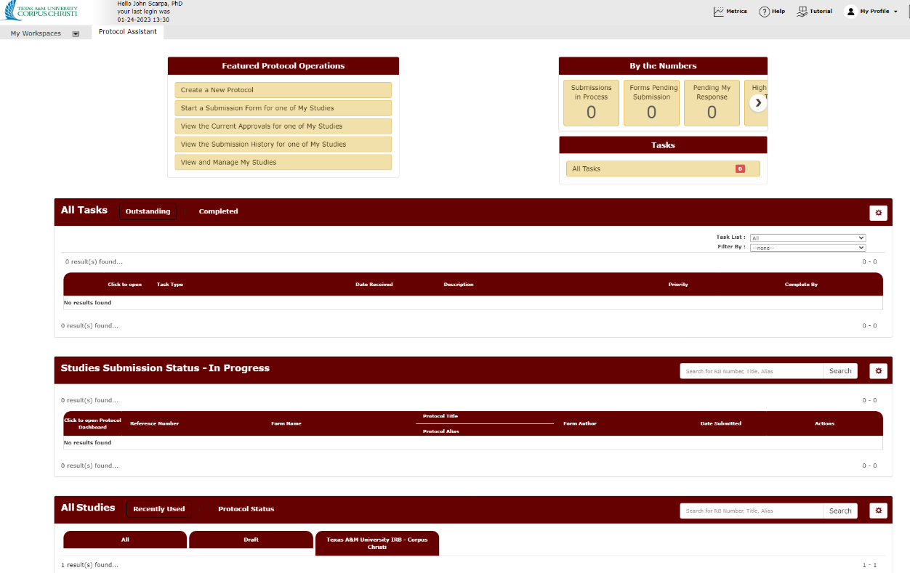
How Do I Get Started?
ALL protocol(s) must be submitted in iRIS
Approval is needed BEFORE starting project

Slide 5
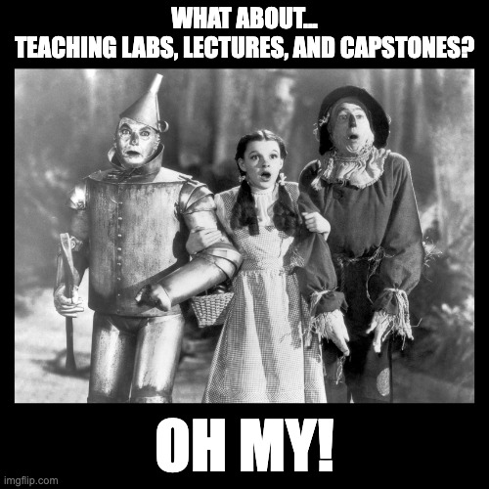

Slide 6
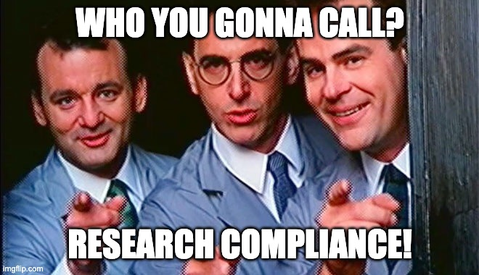

Slide 7
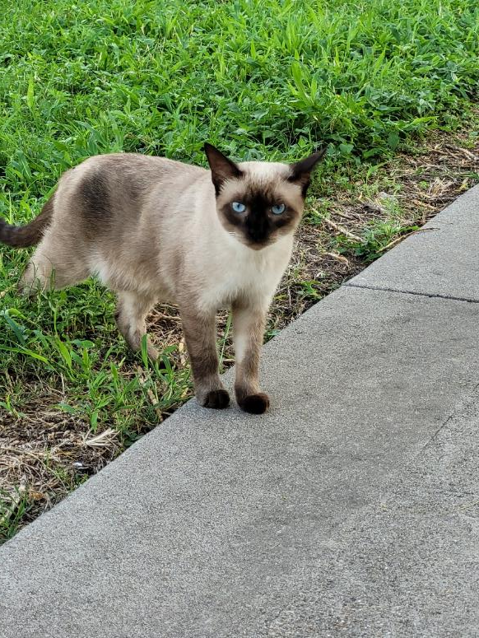
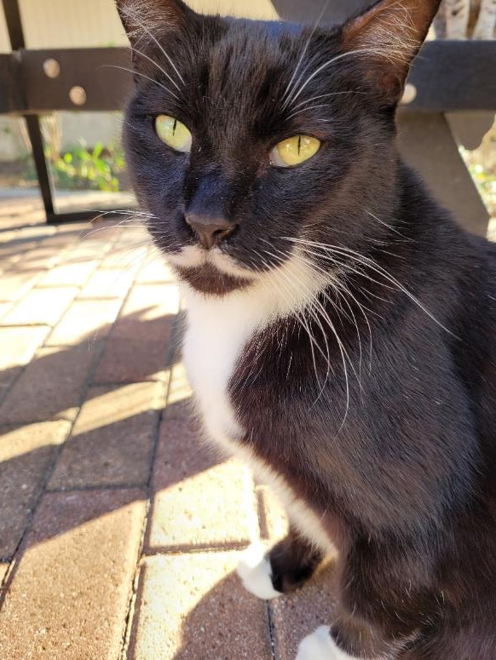
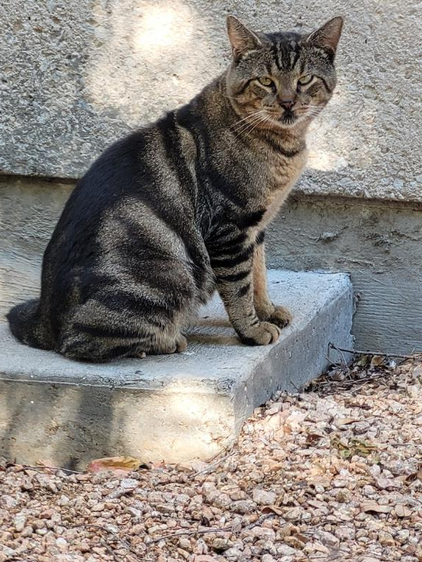
SCENARIOS
Are they covered and by which committee(s)?

Slide 8
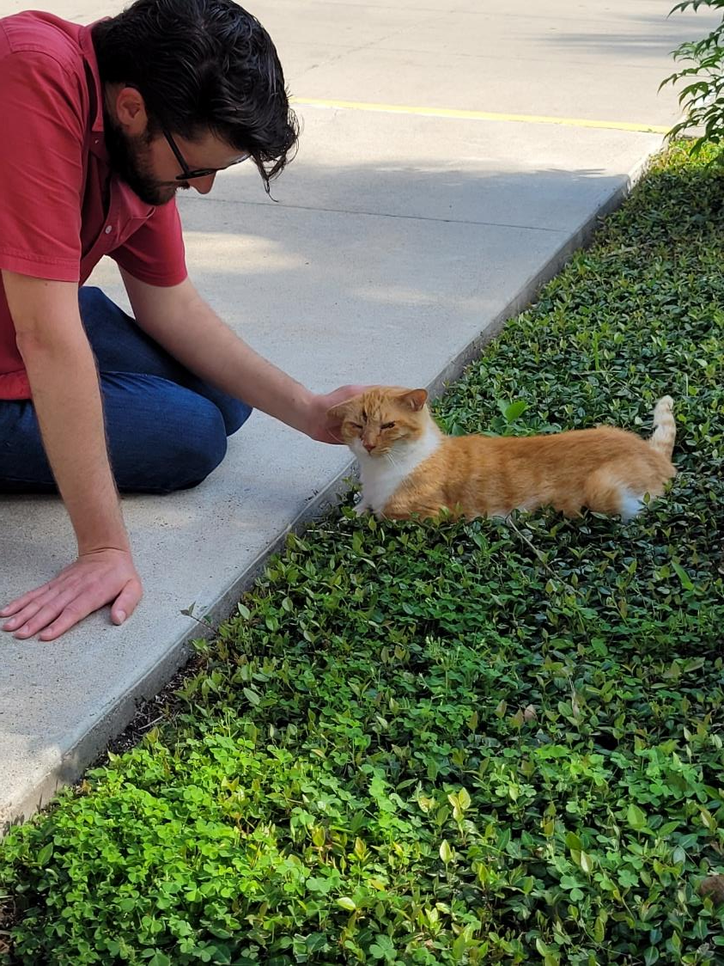
Petting a campus cat

Slide 9



Please download and install the Slido app on all computers you use
Which Research Compliance Office would need to oversee this activity?
ⓘ Start presenting to display the poll results on this slide.

Slide 10
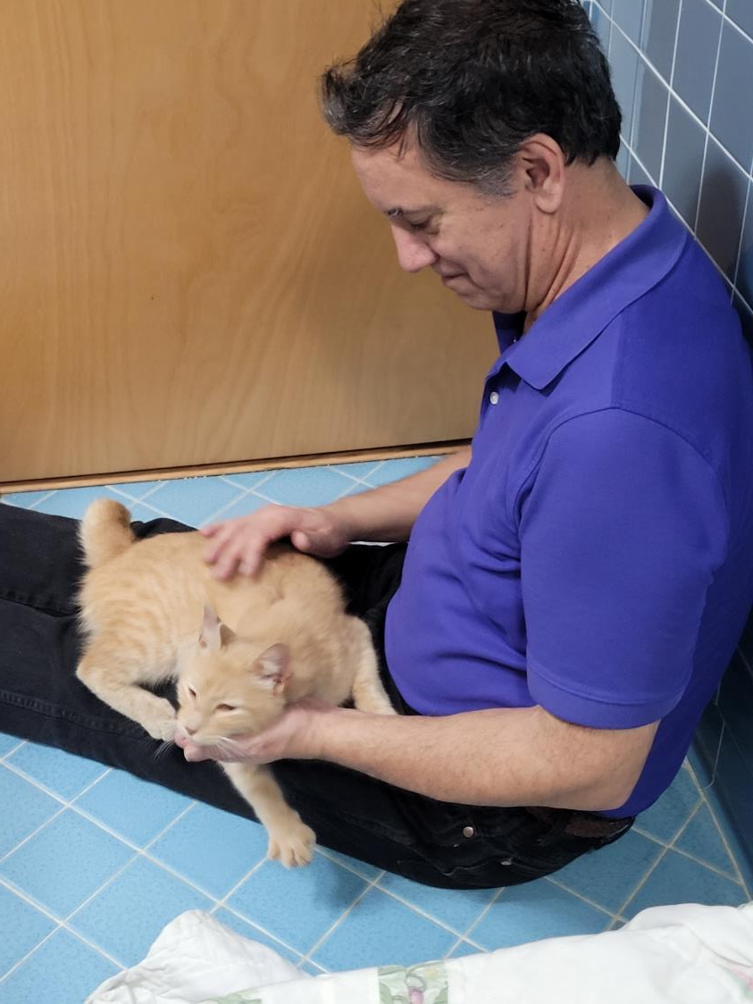
Observe people interacting
with campus cats and collect data on them by asking how they feel before and after interaction.

Slide 11
Please download and install the Slido app on all computers you use
Which Research Compliance Office would need to oversee this activity?
ⓘ Start presenting to display the poll results on this slide.

Slide 12
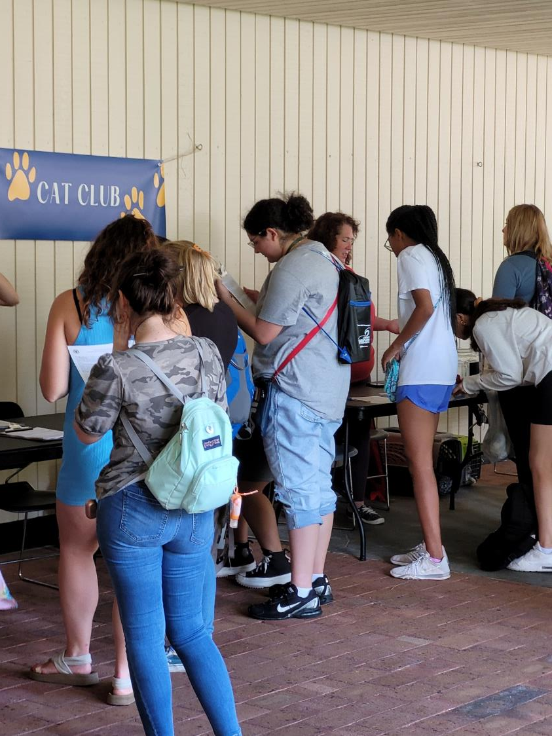
Ask people to interact with
campus cats and take
blood sample from them
(people) before and after
interaction.

Slide 13
Please download and install the Slido app on all computers you use
Which Research Compliance Office would need to oversee this activity?
ⓘ Start presenting to display the poll results on this slide.

Slide 14

Panelists
John Scarpa, IBC/IACUC Coordinator
Larry Lloyd, Dive Safety Officer
Michael Sollitto, IRB Chair and Associate Professor of Communication
Patrick Larkin, IBC Chair and Associate Professor of Chemistry
Wei Xu, IACUC Chair and Associate Professor of Biology
Michelle Eisenman, Research Support Specialist for Human Subjects Research

