Slide 1
Marketing & Communications

Slide 2
overview
Brand & Style Guide
Archetype/who are we?
Storytelling outlets
Media requests
Promotional items
Branded templates
Video as recruitment tool
Ways to partner

Slide 3
Brand & style guide
Established in 2020, latest update March 2025
Full guide available at styleguide.tamucc.edu
Brand personality
Positioning statements and taglines
Brand pillars
Logo usage
Color palette, typography, and photo style
Writing guide
Email signature generator

Slide 4
Brand Archetype
Helps us connect to our audience in a deep and meaningful way
Builds authenticity, loyalty, and trust
Influences behavior
Brand archetypes invented by Carl Jung, Swiss Psychologist in 1940s

Slide 5
How do explore brands behave?
Promise freedom, unique experiences, and ultimately a better world
Are immersed in nature
Are wary of being “tied-down” to anything
Tout their authenticity
Take you somewhere
Discovering unique solutions
Brands: NASA, Jeep, The North Face, Subaru, National Geographic

Slide 6
storytelling outlets
Comm specialist assigned to each college
Web stories
Print publications
Video
Social media
Islander Insider faculty/staff newsletter
Marketing campaigns
CORE (Create once, repurpose everywhere)
Our goal is to say "YES" more than we say no!

Slide 7
Media requests
09.02.01.C1 Official University Messaging
MEDIA
News Releases and Media Alerts: All news releases and media alerts will be sent by MARCOM. Requests for communication to the media should be directed to communications@tamucc.edu.
Interview Requests: MARCOM will reach out to appropriate representatives if the media requests interviews with campus experts. Direct requests for interviews from media representatives should be sent to MARCOM. Interviews should not be granted without MARCOM’s prior knowledge.
The goal is to streamline requests, to help faculty prepare via media training, to decline on your behalf, to help gather visuals, to help media park, to help track metrics to show value, etc.

Slide 8
Promotional Items
3 step process
Internal approval form – routes to Dean and VP
AgoraCX – bid platform
Licensing review and approval
Guidelines for review and approval
Lead with university branding
Focus on student recruitment/retention
Avoid internal giveaway items
Consider available budget
University-wide volunteer shirts

Slide 9
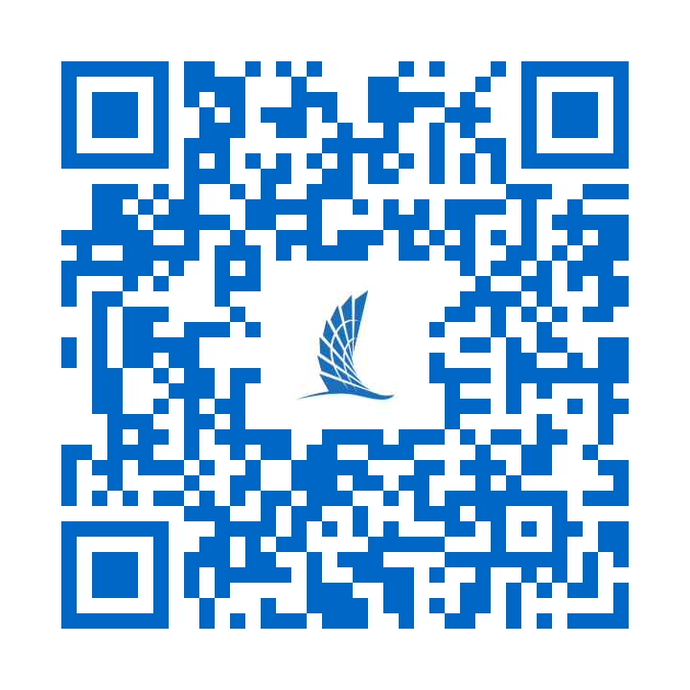
BRANDED DESIGN TEMPLATES
Resource for quick graphics
Pre-made templates in various sizes
Available via Adobe Express
Step-by-step guide and video tutorials
tamu.cc/BrandedTemplates

Slide 10
Video as recruitment tool
We are not the university's historians
Goal with video is to showcase student experience with storytelling, painting a picture of opportunity for our prospective student/explorer
How you can help
Let us know about dynamic, high-impact visual events
Help us coordinate video/photo shoots
Help us identify Islanders with strong testimonials

Slide 11
Ways to partner
Incorporate explorer archetype
Notify MARCOM of media and high-impact visuals
Be a good steward of the university with promotional items
Request services through the MARCOM form
marcom.tamucc.edu

Slide 12
Questions?

